Slide 1
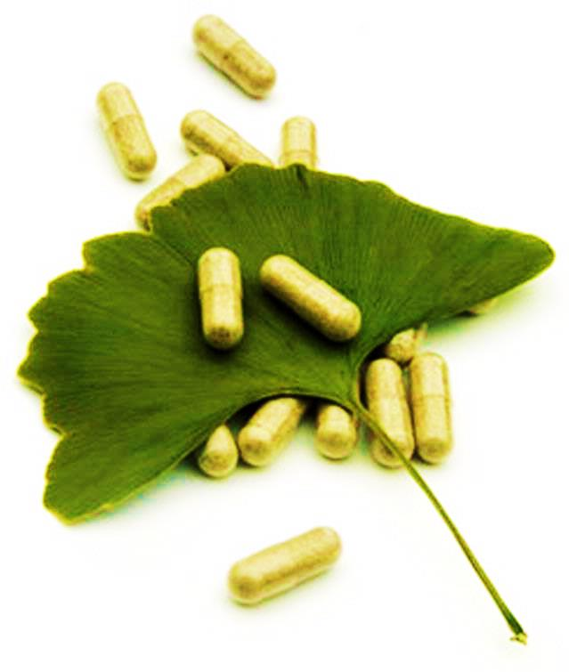
ผลิตภัณฑ์ธรรมชาติเพื่อสุขภาพและความงาม
Natural Products for Health and Beauty
รหัสวิชา 1162202
หน่วยกิต3(2-2-5)
วิชาเอก (เลือก)
อ. ดร. วรวัฒน์ พรหมเด่น
สาขาวิชาวิทยาศาสตร์ทั่วไป คณะครุศาสตร์
มหาวิทยาลัยราชภัฏบุรีรัมย์

Slide 2
สารทุติยภูมิ (Secondary metabolites)
สารอัลคาลอยด์ (Alkaloids)
2. กลุ่มสารฟีนอลิก (phenolic compounds) - Simple Phenols / Phenolic acids / Phonolic glycosides
- Coumarins
- Flavonoids
- Tanins
- Quinones
กลุ่มสารเทอร์พีนอยด์ และ สเตียรอยด์ (Terpenoids and Steroids)
- monoterpenes, sesquiterpenes, diterpenes, triterpene,
tertraterpenes, volatile oils, resins and oleoresins
กลัยโคไซด์อื่นๆ (other glycosides)
- cyanogenic glycosides, glucosinolate compounds

Slide 3
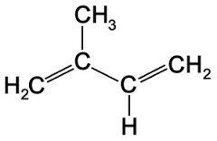
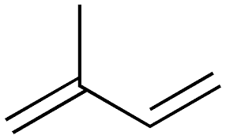
เทอร์พีนอยด์ (Terpenoids)
หรือ เทอร์พีน (Terpenes)
บางครั้งอาจเรียกว่า isoprenoids เป็นสารทุติยภูมิกลุ่มใหญ่ ที่พบมากที่สุดในธรรมชาติ
สามารถพบได้ทั้งในพืชและในสัตว์ พบในฮอร์โมนของแมลง ในสัตว์ทะเลจำนวกฟองน้ำ
เทอพีนอยด์ประกอบด้วยหน่วยย่อยเรียกว่า isoprene unit ซึ่งเป็นสารประกอบ
ไฮโดรคาร์บอนที่มีสูตรเป็น CH₂=C(CH₃)CH=CH₂

Slide 4
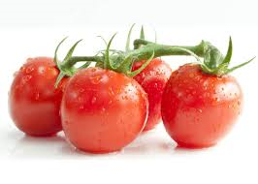
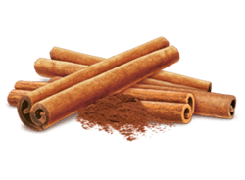
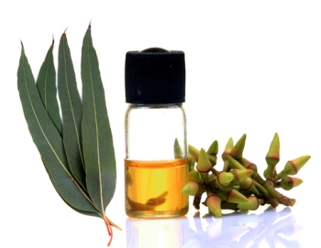
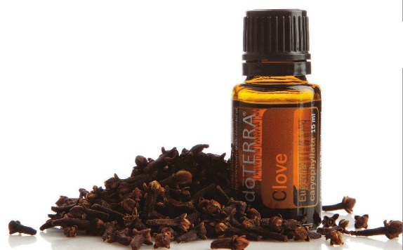
Plant terpenoids are used extensively for their aromatic qualities and play a role in traditional herbal remedies. Terpenoids contribute to the scent of eucalyptus, the flavors of cinnamon, cloves, and ginger, the yellow color in sunflowers, and the red color in tomatoes.
cinnamon
Eucalyptus essential oil
Clove essential oil

Slide 5
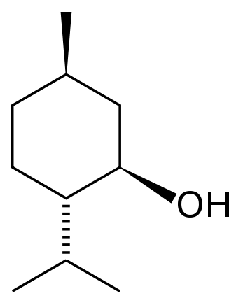
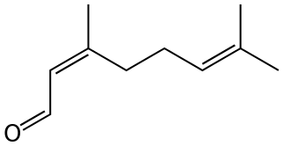
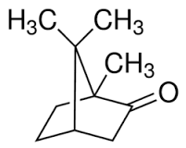
Well-known terpenoids include citral, menthol, camphor.
Geranial (E-isomer of citral)
menthol
Neral (Z-isomer of citral)
camphor

Slide 6
Structure and classification
The terpenoids can be classified according to the number of isoprene units used:
Hemiterpenoids, 1 isoprene unit (5 carbons)
Monoterpenoids, 2 isoprene units (10C)
Sesquiterpenoids, 3 isoprene units (15C)
Diterpenoids, 4 isoprene units (20C) (e.g. ginkgolides)
Sesterterpenoids, 5 isoprene units (25C)
Triterpenoids, 6 isoprene units (30C) (e.g. sterols)
Tetraterpenoids, 8 isoprene units (40C) (e.g. carotenoids)
Polyterpenoid with a larger number of isoprene units

Slide 7
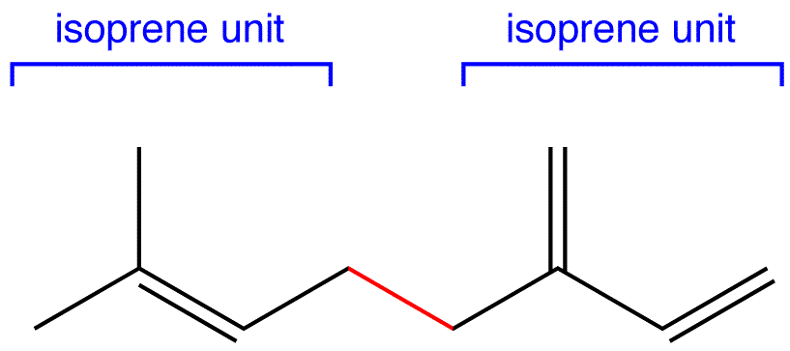

Slide 8
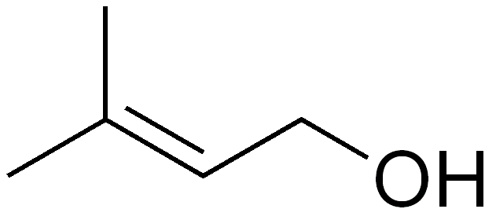
Hemiterpenes consist of a single isoprene unit. Isoprene itself is considered the only hemiterpene, but oxygen-containing derivatives such as prenol and isovaleric acid are hemiterpenoids.
prenol
isovaleric acid
Prenol occurs naturally in citrus fruits, cranberry, bilberry, currants, grapes, raspberry, blackberry, tomato
(3-Methylbutanoic acid)
isovaleric acid is a major component of the cause of unpleasant foot odor, as it is produced by skin bacteria metabolizing leucine.

Slide 9
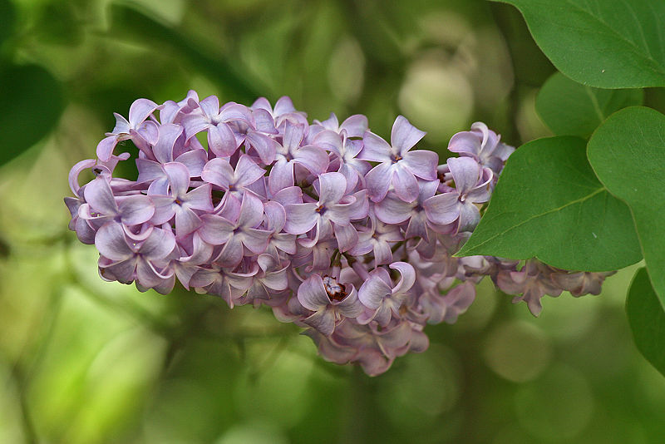
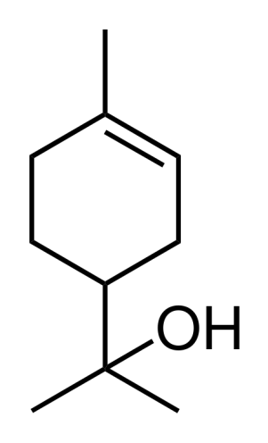
Monoterpenes consist of two isoprene units and have the molecular formula C₁₀H₁₆. Examples of monoterpenes and monoterpenoids include geraniol, terpineol (present in lilacs), limonene (present in citrus fruits), myrcene (present in hops), linalool (present in lavender) or pinene (present in pine trees)
Terpineol
Syringa vulgaris
(lilacs)
Geraniol
Family: Oleaceae

Slide 10
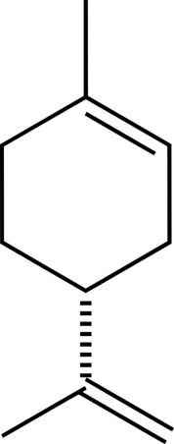
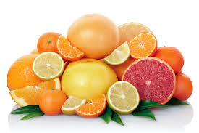
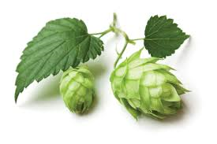
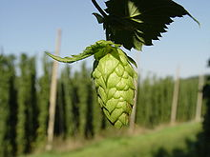
Monoterpenes
citrus fruits
Family: Rutaceae
limonene
myrcene
Hop flower
Humulus lupulus
Family: Cannabaceae

Slide 11
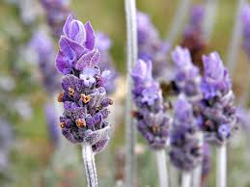
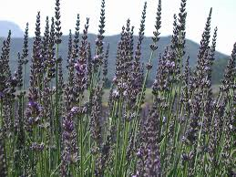
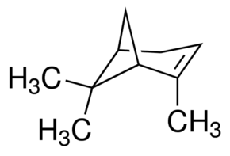
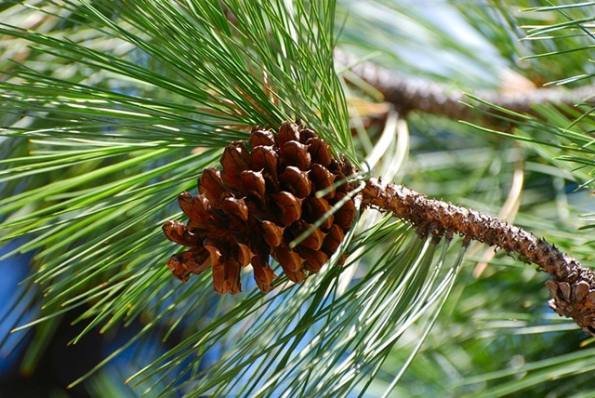
Monoterpenes
Portuguese lavender
linalool
Lavandula latifolia
Family: Lamiaceae
(+)-α-Pinene
pine trees
Family: Pinaceae

Slide 12
Sesquiterpenes consist of three isoprene units and have the molecular formula C₁₅H₂₄. Examples of sesquiterpenes and sesquiterpenoids include humulene, farnesene, farnesol, gossypol, picrotoxin, santonin, artemisnin.
Chemical structure
Plant name / plant organ
Usefulness
(The sesqui- prefix means one and a half.)

Slide 13
Diterpenes are composed of four isoprene units and have the molecular formula C₂₀H₃₂. They derive from geranylgeranyl pyrophosphate. Examples of diterpenes and diterpenoids are cafestol, kahweol, cembrene and taxadiene (precursor of taxol), stevioside, andrographolide and plaunotol. Diterpenes also form the basis for biologically important compounds such as retinol, retinal, and phytol.
Chemical structure
Plant name / plant organ
Usefulness

Slide 14
Sesterterpenes, terpenes having 25 carbons and five isoprene units, are rare relative to the other sizes. (The sester- prefix means half to three, i.e. two and a half.) An example of a sesterterpenoid is geranylfarnesol.
Chemical structure
Plant name / plant organ
Usefulness

Slide 15
Triterpenes consist of six isoprene units and have the molecular formula C₃₀H₄₈. The linear triterpene squalene, the major constituent of shark liver oil, is derived from the reductive coupling of two molecules of farnesyl pyrophosphate. Squalene is then processed biosynthetically to generate either lanosterol or cycloartenol, the structural precursors to all the steroids.
Chemical structure
Plant name / plant organ
Usefulness

Slide 16
Sesquarterpenes are composed of seven isoprene units and have the molecular formula C₃₅H₅₆. Sesquarterpenes are typically microbial in their origin. Examples of sesquarterpenoids are ferrugicadiol and tetraprenylcurcumene.
Chemical structure
Plant name / plant organ
Usefulness

Slide 17
Tetraterpenes contain eight isoprene units and have the molecular formula C₄₀H₆₄ . Examples of tetraterpenes are capsanthin and capsorubin extracted from the fruits of Capsicum annuum or Capsicum frutescens. Biologically important tetraterpenoids include the acyclic lycopene, the monocyclic gamma-carotene, and the bicyclic alpha- and beta-carotenes.
Chemical structure
Plant name / plant organ
Usefulness

Slide 18
Polyterpenes consist of long chains of many isoprene units. Natural rubber consists of polyisoprene in which the double bonds are cis. Some plants produce a polyisoprene with trans double bonds, known as gutta-percha.
Chemical structure
Plant name / plant organ
Usefulness

