Slide 1
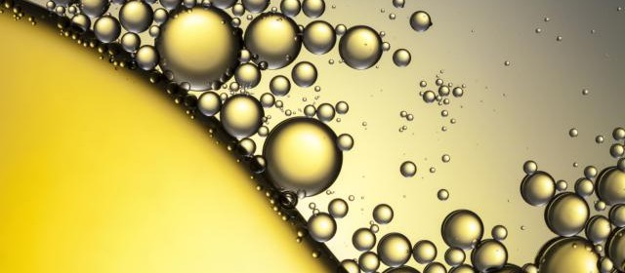
Lesson 6
Lipid Nutrition

Slide 2
Lipids
Category of compounds that includes
  Triglycerides
  Sterols
  Phospholipids
Contain carbon, oxygen, and hydrogen
Hydrophobic

Slide 3
Lipids
Basic functions in the body
  Store and provide energy
      Fats provide 9 kcal per gram
  Provide insulation
  Help manufacture steroids and bile salts
  Play a role in transporting fat-soluble nutrients in the blood
  Used to manufacture major sex hormones
  Key to the structure of cell membranes

Slide 4
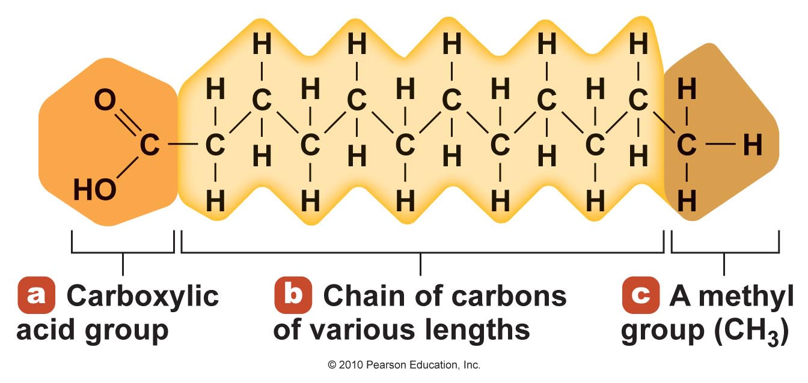
Fatty Acids
Building blocks for triglycerides and phospholipids
A chain of carbon and hydrogen atoms with a carboxyl group at the alpha end and a methyl group at the omega end

Slide 5
Fatty Acids
Higher ratio of carbon and hydrogen to oxygen than in carbohydrates and protein
  9 kilocalories per gram of fat
20 different fatty acids with varied length, saturation, and shape

Slide 6
Fatty Acids Vary in Length
Short-chain fatty acids
  Two to four carbons
  Weak attraction
  Liquid at room temperature
Medium-chain fatty acids
  Six to ten carbons

Slide 7
Fatty Acids Vary in Length
Long-chain fatty acids
  12 or more carbons
  Most common type of fatty acid in foods
  Strong attraction
  Solid at room temperature

Slide 8
Fatty Acids Vary in Saturation
Saturated
  All the carbons on the fatty acid are bound to hydrogen
  Solid at room temperature
  Higher melting point

Slide 9
Fatty Acids Vary in Saturation
Unsaturated
  Some carbons on fatty acid form a double bond with each other instead of binding to hydrogen
  Monounsaturated fatty acids (MUFA)
    Has one double bond
  Polyunsaturated fatty acid (PUFA)
    Has two or more double bonds
  Liquid at room temperature
  Lower melting point

Slide 10
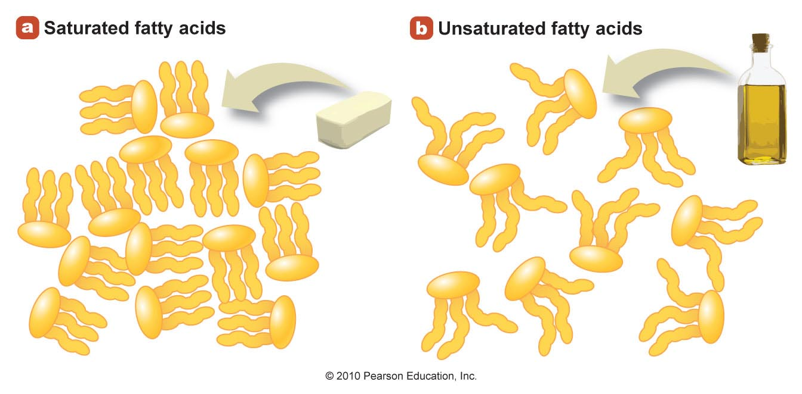
Saturated and Unsaturated Fatty Acids Help Shape Foods
Figure 5.3

Slide 11
Fatty Acids Differ in Double-Bond Location
The location of the first double bond in unsaturated fatty acids effect the omega-3 fatty acid and omega-6 fatty acid
Omega-3 fatty acid
  First double bond is between the third and fourth carbon from the omega end
  Example: Alpha-linolenic acid
    One of the two essential fatty acids

Slide 12
Fatty Acids Differ in Double-Bond Location
Omega-6 fatty acid
  First double bond is between the sixth and seventh carbon from the omega end
  Example: Linoleic acid
    One of the two essential fatty acids

Slide 13
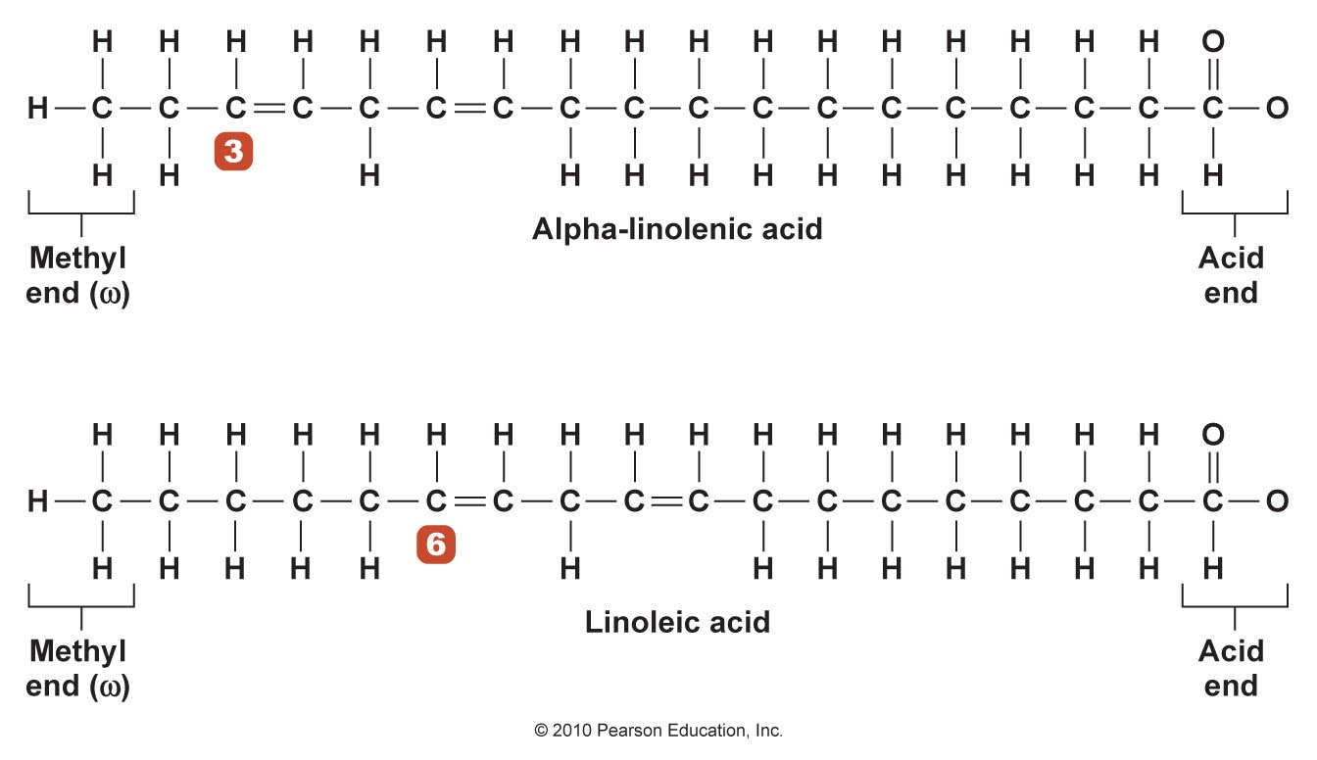
The Omega Fatty Acids

Slide 14
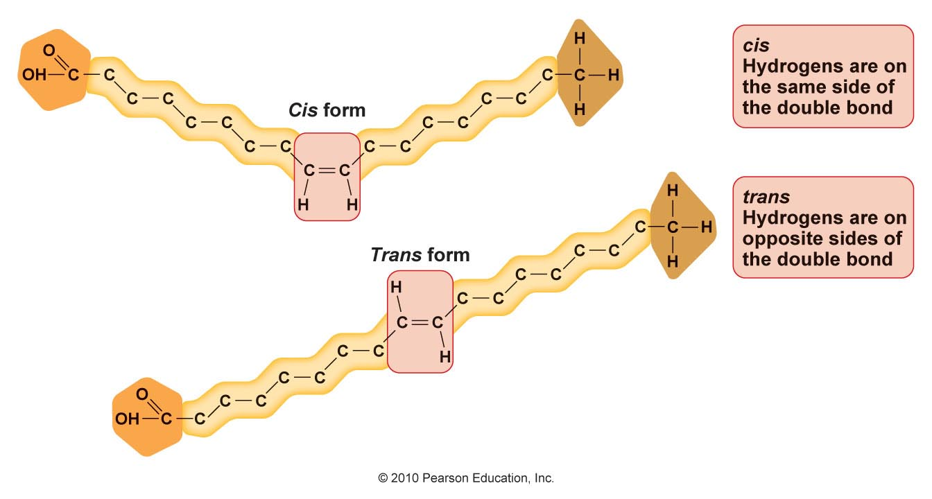
Fatty Acids Vary in Shape
Unsaturated fatty acids form two different shapes

Slide 15
Fatty Acids and Rancidity
Rancidity: spoiling of fats through oxidation
  More double bonds therefore more susceptible to oxidation and rancidity
PUFA > MUFA > Saturated fatty acids
Enhancing stability of fatty acids by reducing rancidity
  Adding antioxidants
  Limiting food exposure to oxygen, heat, and light
  Hydrogenation

Slide 16
Quick Review
Fatty acids
  Carbon and hydrogen chain, carboxylic acid, methyl group
  Basic structural units of triglycerides and phospholipids
  Differ in chain length, degree of saturation, shape
    Saturated fatty acids: no double bonds
    Monounsaturated fatty acids: one double bond
    Polyunsaturated fatty acids: two or more double bonds
  Essential fatty acids
    Lenoleic
    Alpha-linolenic acid
  Food manufactures hydrogenate or add antioxidants to fatty acids to reduce susceptibility to rancidity

Slide 17
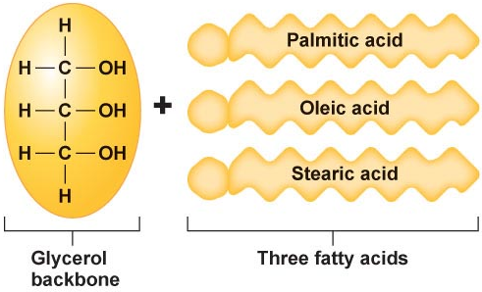
Triglycerides
Three fatty acids connected to a glycerol backbone

Slide 18
Triglycerides
Caution:
High levels in the blood are a risk factor for heart disease
Most common lipid in both foods and the body
Make up about 95% of lipids found in foods
Functions
  Add texture
  Makes meats tender
  Preserves freshness
  Stores as adipose tissue
  for energy

Slide 19
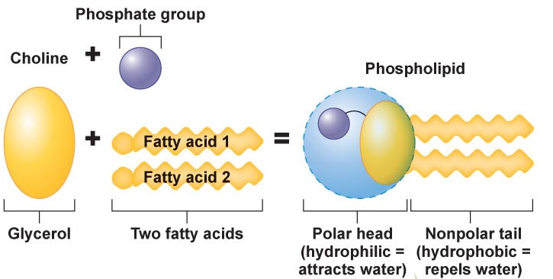
Phospholipids
Hydrophilic on one end; hydrophobic on the other
Make up the phospholipid bilayer in the cell membrane
  Lecithin (a.k.a. phosphatidylcholine)
    A major phospholipid in the cell membrane
    Used as an emulsifier in foods
Synthesized by the liver

Slide 20
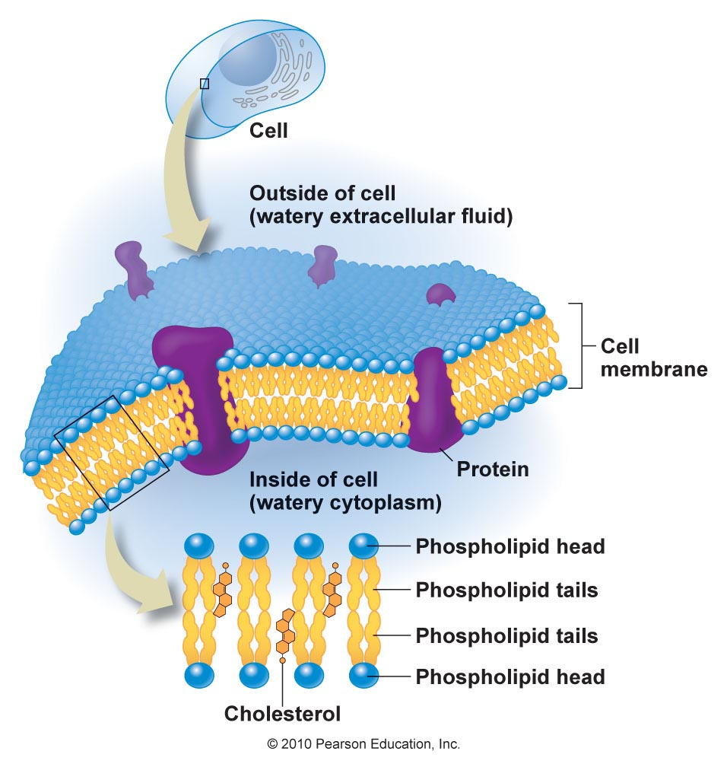
Phospholipids’ Role in Cell Membranes

Slide 21
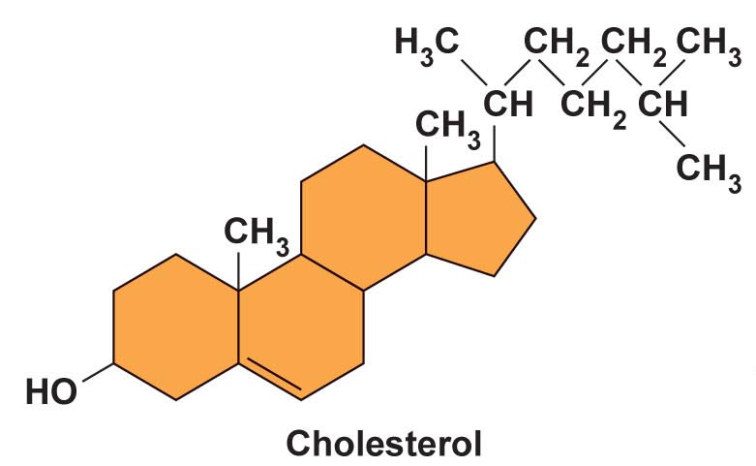
Sterols
More complex than phospholipids or triglycerides
  Four connecting rings of carbon and hydrogen
Do not provide energy
Cholesterol is the best known sterol
  Found in every cell in the body
  Helps with numerous body processes
Phytosterols – major plant sterols

Slide 22
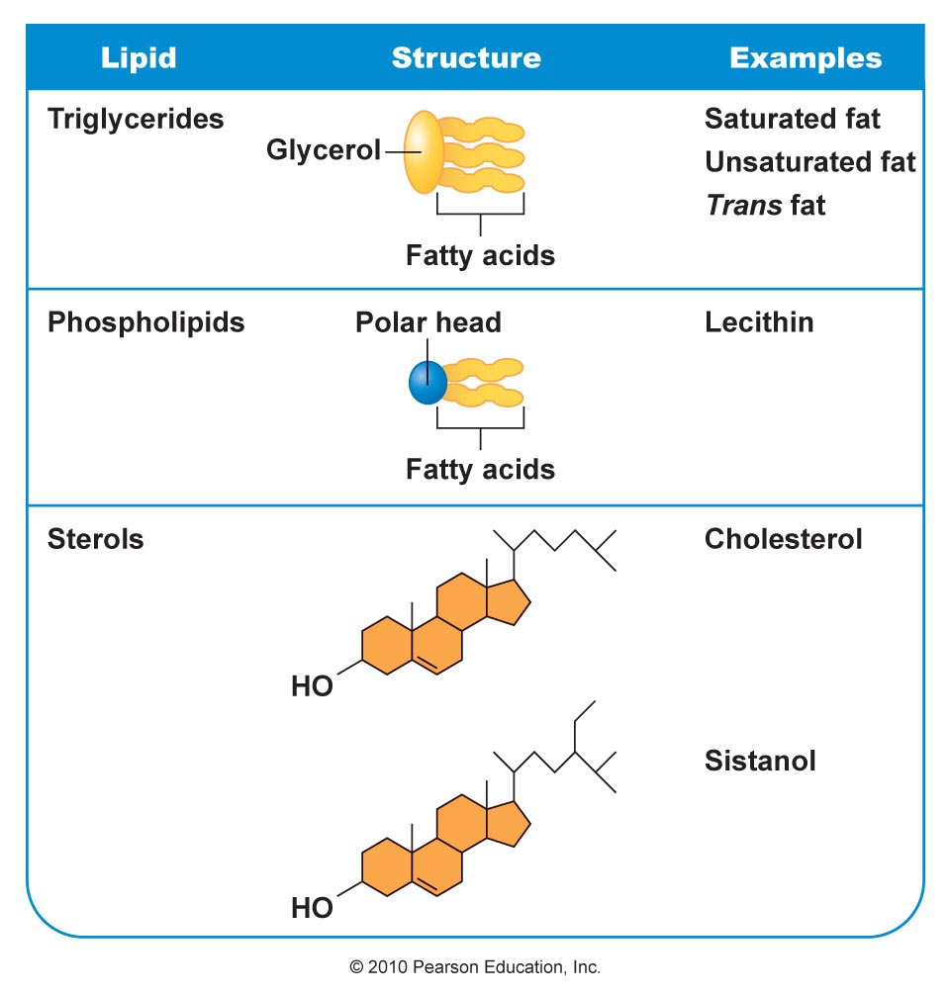
Quick Review

Slide 23
Quick Review
Triglycerides
  Found in the body
  Stored in the adipose tissue
  Major source of energy
Phospholipids
  An important part of cell membrane structure
  Lecithin
    Important to cell membrane
    Used as a food emulsifier
Sterols
  Do not contain fatty acids
  Do not provide energy

Slide 24
What Happens to the Lipids You Eat?
Lipids from foods
  Fat, phospholipids, and sterols
Digested to
  Free fatty acids, glycerol, and monoglycerides
With the aid of the enzyme lipase

Slide 25
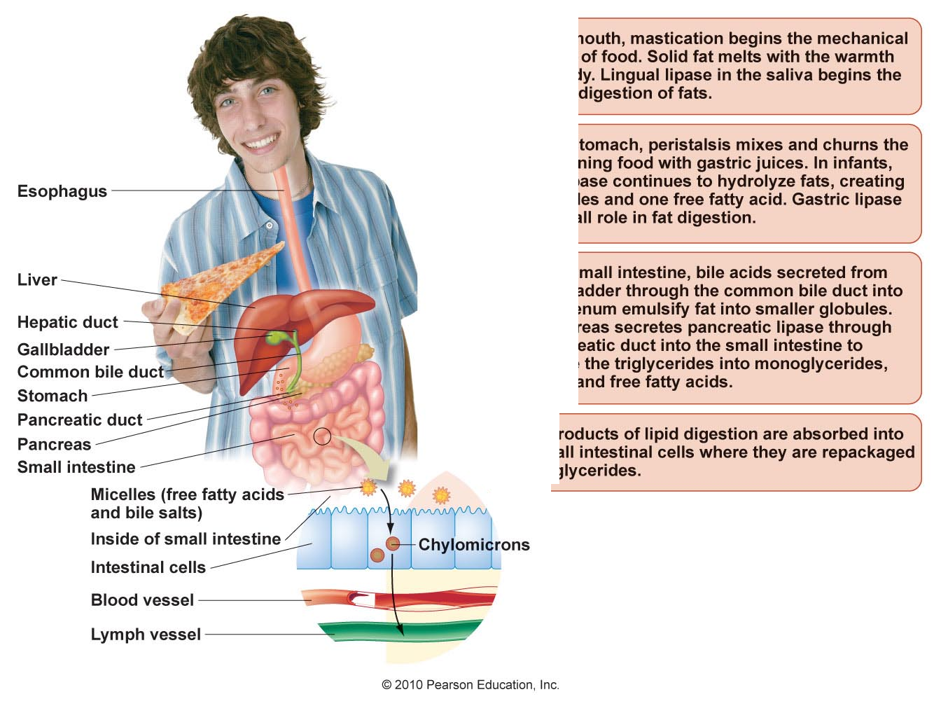
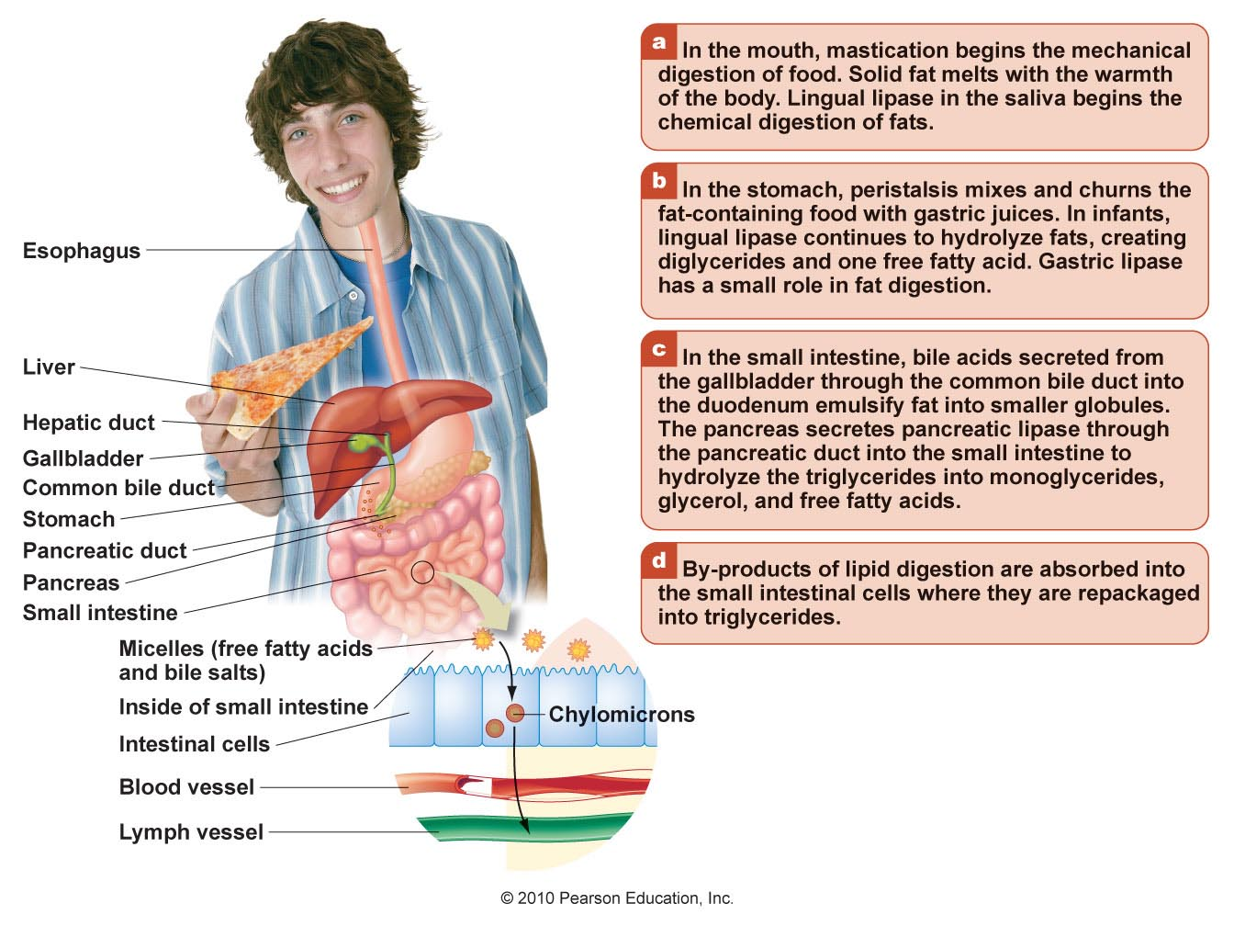
Figure 5.13

Slide 29
Most Fat Is Digested and Absorbed in the Small Intestine
Fat tends to cluster in chyme
Fat stimulates the secretion of cholecystokinin (CCK) in the duodenum
CCK stimulates the gallbladder to release bile acid
Cholecystokinin is a peptide hormone of the gastrointestinal system responsible for stimulating the digestion of fat and protein.

Slide 30
Most Fat Is Digested and Absorbed in the Small Intestine
Phospholipids
  Emulsified by bile
  Dismantled into two free fatty acids and the phospholipid remnant
  Packaged as micelles
  Transported through intestinal wall

Slide 31
Most Fat Is Digested and Absorbed in the Small Intestine
Sterols
  Not digested
  Absorbed intact through intestinal wall
If undigested and absorbed in small intestine
  Bind with fiber
  Eliminated in the feces

Slide 32
Chylomicrons Facilitate Lipid Absorption
Lipids are absorbed based on structure and circulatory system
  Glycerol and short- to medium-chain fatty acids
  Long-chain fatty acids
    Combine with phospholipids and cholesterol
    chylomicrons

Slide 33
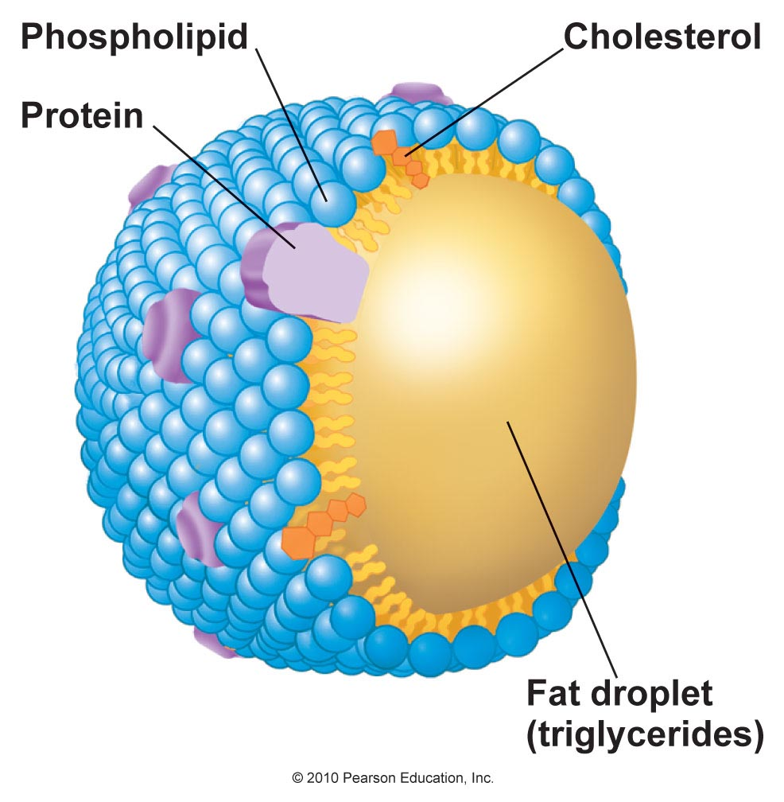
Chylomicrons Facilitate Lipid Absorption
Chylomicrons are too large to be absorbed directly into the bloodstream
  Travel through lymph fluid
  Enter blood stream through thoracic duct next to the heart

Slide 34
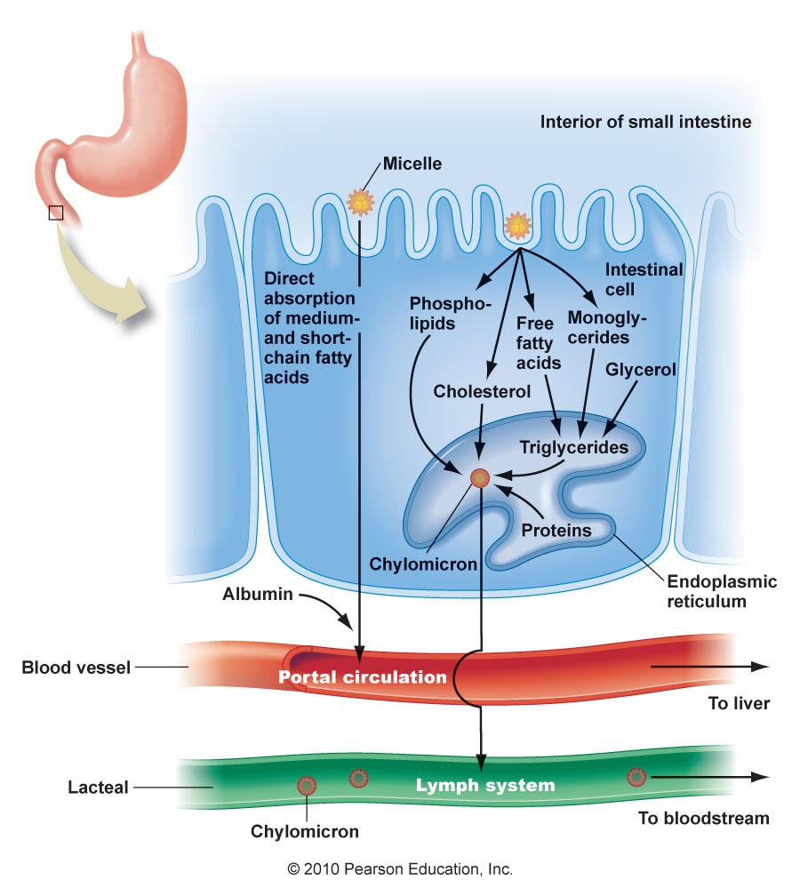
Absorption of Dietary Lipids

Slide 35
Lipoproteins Transport Fat Through the Lymph and Blood
Lipoproteins
  Chylomicrons
  Very low-density lipoproteins (VLDLs)
  Low-density lipoproteins (LDLs)
  High-density lipoproteins (HDLs)

Slide 36
Lipoproteins Transport Fat Through the Lymph and Blood
VLDLs, LDLs, and HDLs
  Globular molecule with a lipid center surrounded by a plasma membrane
  Density determines function
  More protein, higher density

Slide 37
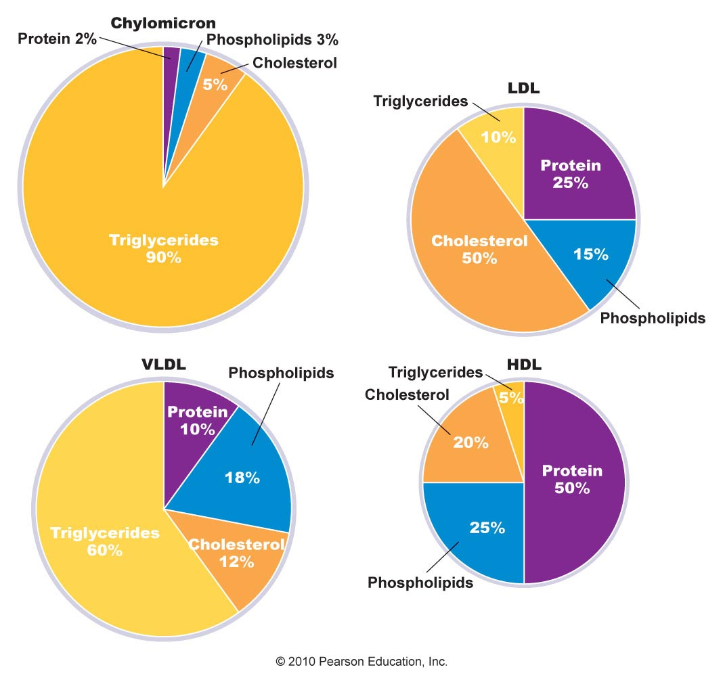
The Ratio of Protein to Lipid Determines the Density of the Lipoprotein

Slide 38
Lipoproteins Transport Fat Through the Lymph and Blood
Very low-density lipoproteins (VLDLs)
  Become LDLs
LDLs: “bad” cholesterol
HDLs: “good” cholesterol
HDL and LDL levels can be used to determine the health of arteries

Slide 39
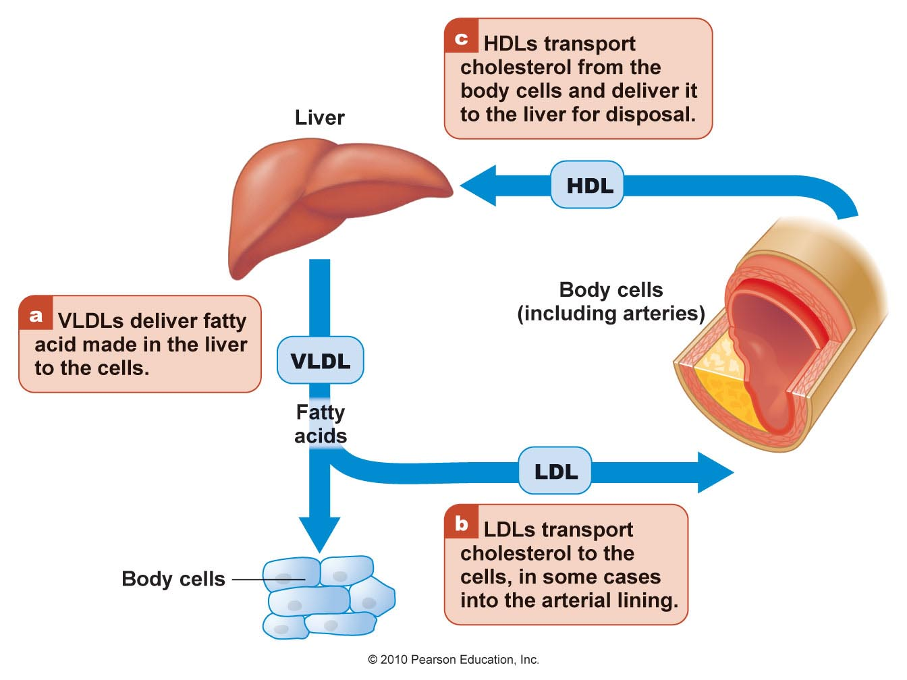
The Roles of VLDL, LDL, and HDL Lipoproteins
Figure 5.18

Slide 40
Quick Review
Most fats are digested in the small intestine with the help of bile acids and pancreatic lipase
Short- and medium-chain fatty acids are absorbed directly into the bloodstream
Longer chain fatty acids and other remnants of fat digestion
  Packaged in chylomicron lipoprotein carriers
  Travel in lymph before entering the bloodstream
Lipoproteins are globularshaped transport carriers
  Outer shell high in protein and phospholipids
  Inner core carries insoluble fat, cholesterol, and other lipids through lymph and bloodstream

Slide 41
Quick Review
VLDLs and HDLs are synthesized in the liver
VLDLs eventually become LDLs after depositing some fatty acids in the body’s cells
LDLs deposit cholesterol in the cells and arterial walls
HDLs remove cholesterol from the arteries and deliver it to the liver to be used in the synthesis of bile or excreted in the feces

Slide 42
Uses of Fat and Cholesterol
Source of energy
Form body structures
Regulate metabolism
Enhance absorption of fat-soluble vitamins
Provide insulation to help regulate body temperature
Cushion major organs

Slide 43
Fat Is Used as Energy
Fat
  Provides concentrated source of kilocalories
    9 kilocalories per gram
  Readily available when the body needs energy
  Body’s main source of energy throughout the day

Slide 44
Fat Is Used as Energy
Fat
  Body has an unlimited ability to store excess energy as fat in adipocytes
    Fat cells have the capacity to enlarge as much as 1,000 times their original size
    Body has the ability to produce additional fat cells

Slide 45
Fat Is Used as Energy and Helps Absorb Lipid Compounds
Preferred source of energy for the heart, liver, and muscles
Cannot sustain life alone
Needs glucose
  Only glycerol can be used for gluconeogenesis
Several essential nutrients require dietary fat for absorption
20 grams per day are needed to stimulate chylomicrons that transport fat-soluble vitamins

Slide 46
Fat Helps Insulate and Protect
Fat in subcutaneous tissue
  Insulates body
  Maintains body temperature
Fat protects bones and vital organs from trauma
  Too much fat eliminates the protective benefit

Slide 47
Essential Fatty Acids, Eicosanoids, and Cell Membrane
Linoleic acid can be elongated and converted to arachidonic acid
Alpha-linolenic acid
  Converts to eicosapentaenoic acid (EPA)
    EPA elongates to docosahexaenoic acid (DHA)
  Needed for healthy cell membranes

Slide 48
Essential Fatty Acids, Eicosanoids, and Cell Membrane
EPA and arachidonic acid are used to manufacture eicosanoids
Eicosanoids are hormonelike substances
  Prostaglandins, thromboxanes, and leukotrienes
  Regulate the immune system, blood clotting, inflammation, and blood pressure

Slide 49
Cholesterol Is Used to Make Bile, Hormones, and Vitamin D
Cholesterol
  A structural part of the cell membrane
  A precursor to vitamin D
  A precursor to bile acid
  Precursor for sex hormones such as estrogen and testosterone

Slide 50
Quick Review
  Regulate the immune system
  Regulate blood clotting
  Regulate inflammation
  Regulate blood pressure
Fat
  An energy-dense source of fuel
  Cushions and protects bones, organs, and nerves
  Helps maintain body temperature
  Provides essential fatty acids
  Is needed for the absorption of fat-soluble vitamins and carotenoids
Essential fatty acids are precursors to EPA and DHA which manufacture
  Prostaglandins
  Thromboxanes
  Leukotrienes

Slide 51
Quick Review
Essential functions of cholesterol
  Is part of cell membrane
  Is needed to make
    Vitamin D
    Bile acid
    Sex hormones

Slide 52
How Much Fat Do We Need Each Day?
Overall intake of fat in the U.S. is higher than it should be
Acceptable Macronutrient Distribution (AMDR) recommendation
  20–35% of daily kilocalories should come from fat
For heart health
  Consume no more than 10% of total kilocalories from saturated fat
  Limit trans fats to < 1%

Slide 53
Essential Fatty Acid Recommendations
Adequate Intake (AI) for the essential fatty acids
  Alpha-linolenic acid
    Men 1.6 grams/d
    Women 1.1 grams/d
  Linoleic acid
    Men 17 grams/d
    Women 12 grams/d
*Currently Americans only consume about 0.1–0.2 grams/d of EPA and DHA

Slide 54
Essential Fatty Acid Recommendations
AMDR for the essential fatty acids
  0.6–1.2% of total kilocalories should be alpha-linolenic acid
  5–10% of total kilocalories should be linoleic acid
American Heart Association recommendations
  People diagnosed with heart disease should consume ~1 gram of essential fatty acids per day

Slide 55
Facts About Fats, Oils, and Cholesterol
Intake of trans fats and saturated fats correlate with increased risk of
  Cardiovascular disease
  Stroke
  Cancer
Substituting or replacing trans fats and saturated fats with MUFA and PUFA can lower risk

Slide 56
Dietary Cholesterol Is Not Essential
The liver synthesizes cholesterol needed by the body
  Liver synthesizes ~900 mg/d
  Liver decrease synthesis based on dietary intake
To reduce the risk of cardiovascular disease, dietary cholesterol should be limited to < 300 mg/d

Slide 57
Quick Review
Dietary lipids are an important part of a healthy diet, especially essential fatty acids
Saturated fat, trans fats, and cholesterol intake should be limited
Dietary fat intake per day
  Should range from 20 to 35% of total kilocalories
  5–10% of kilocalories from linoleic acid
  0.6–1.2% of kilocalories from alpha linolenic acid
  Limit saturated fat intake to < 10% of total fat intake
  Limit trans fat intake to < 1% of total fat intake
  Limit cholesterol intake to < 300 mg

Slide 58
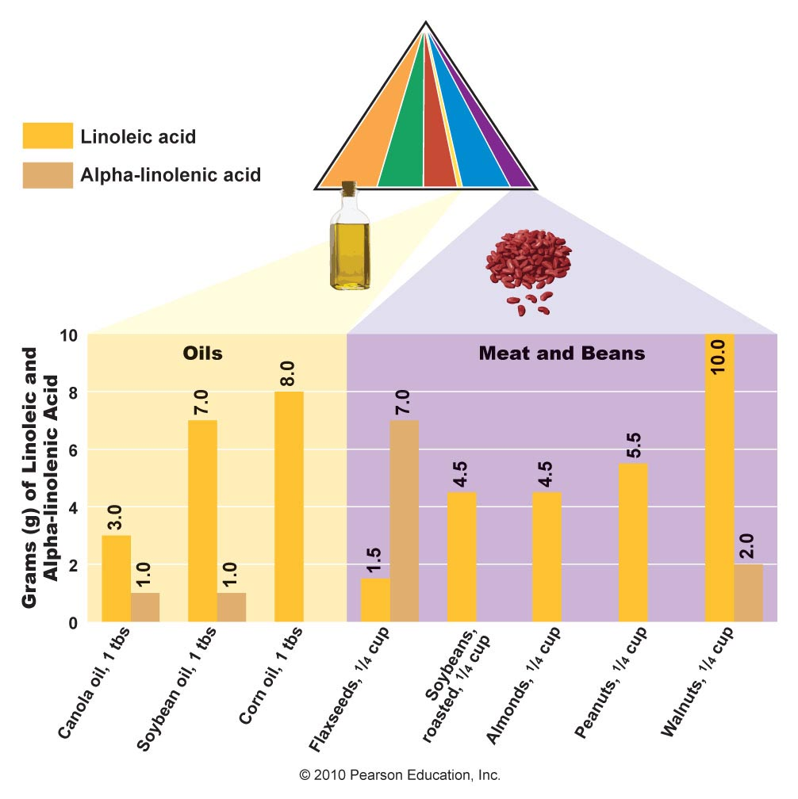
Best Food Sources of Fat
Sources of unsaturated fats

Slide 59
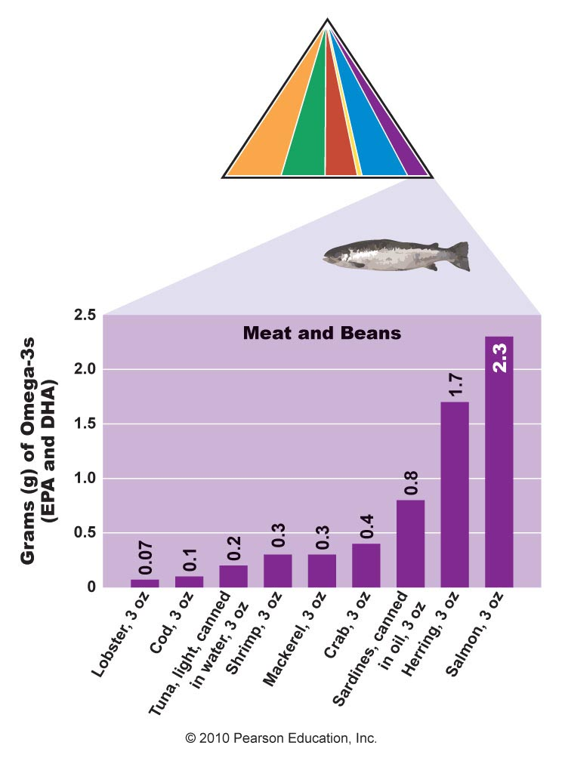
Food Sources of Omega-3 Fatty Acids

Slide 60
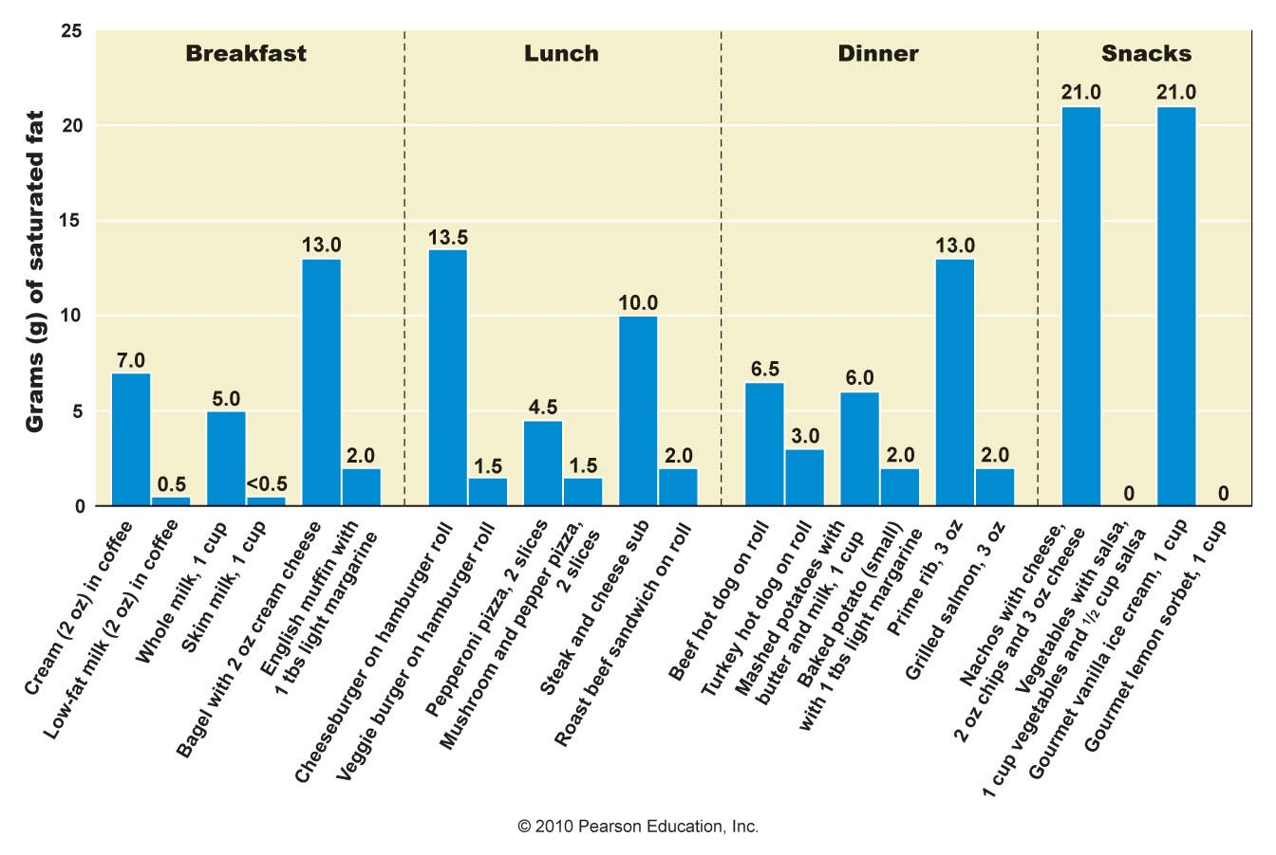
Where’s the Saturated Fat in Foods?

Slide 61
Quick Review
Lean meat and poultry, fish, low-fat or nonfat dairy products and limited amounts of nuts and cheese
  Best sources of essential fatty acids
  Limit intake of saturated and trans fats
Commercially prepared baked goods and snack items
  Are high in kilocalories
  Are high in saturated and trans fats
  Should be consumed rarely
Use vegetable oils in the place of butter

Slide 62
Foods Containing Trans Fat and Cholesterol?
Hydrogenated fats are used by many commercial food producers to
  Provide rich texture
  Increase shelf live
  Decrease incidence of rancidity
During the hydrogenation process trans fats form
Some trans fats are naturally occurring

Slide 63
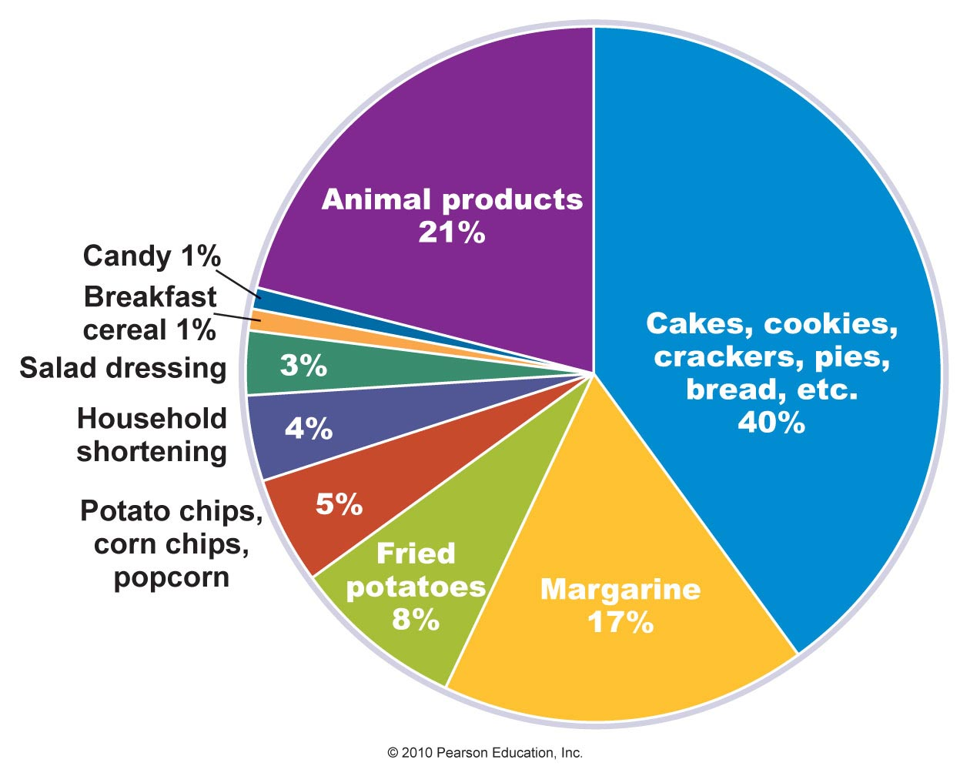
Major Food Sources of Trans Fat for Adults

Slide 64
Trans Fats
Trans fat may actually be worse for heart health than saturated fats
  Raise LDL cholesterol
  Lower HDL cholesterol
FDA requires trans fat to be listed on food labels
The food industry is working to find replacements for trans fats in foods

Slide 65
Food Sources of Cholesterol and Plant Sterols
Cholesterol comes mainly from animal products
The cholesterol produced in plant cell walls and oils is so minimal they are considered cholesterol free
Phytosterols and stanols
  Lower LDL levels by competing with cholesterol for absorption
  Are found in soybean oil, many fruits, vegetables, legumes, sesame seeds, nuts, cereals, and other plant foods
  Food manufacturers are fortifying foods with them to help lower cholesterol

Slide 66
Quick Review
Trans fats are made by heating oil and adding hydrogen gas to saturate the carbons of the fatty acids
Trans fats raise LDL cholesterol and lower HDL cholesterol
Trans fats are found in many commercially prepared foods and must be listed on the food label
Other oils are being tested to replace trans fats in foods
Cholesterol is found mostly in animal products
Phytosterols are found in vegetable oils, nuts, legumes, whole grains, fruits, and vegetables

Slide 67
Fat Substitutes
Designed to provide the creamy properties of fat for fewer kilocalories
Fall into three categories
  Carbohydrate-based: Majority of fat substitutes
  Protein-based: Provide a creamy texture in the mouth
  Fat-based: Give physical attributes of fat for fewer kilocalories
Overconsumption of kilocalories from regular, low-fat, or fat-free products can lead to weight gain

Slide 68
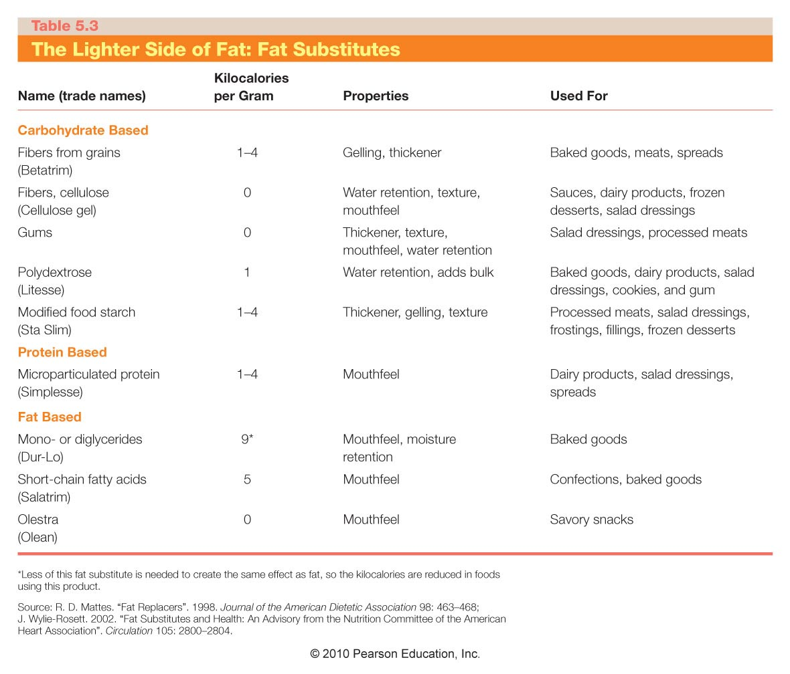

Slide 69
Quick Review
Fat substitutes provide the properties of fat for fewer kilocalories and grams of fat
Fat substitutes can be carbohydrate based, protein based, or fat based
Some substitutes such as olestra work by passing unabsorbed through the GI tract
Reduced-fat and fat-free foods still contain kilocalories and should be eaten in limited amounts

Slide 70
Quick Review
Heart disease is the leading cause of death in the United States
It develops when atherosclerosis causes narrowing of the coronary arteries and decreased flow of oxygen and nutrients to the heart
Elevated LDLs are a major risk factor
Uncontrollable risk factors include age, gender, family history, and type 1 diabetes
Controllable risk factors include type 2 diabetes, high blood pressure, smoking, physical inactivity, excess weight, low HDLs, elevated LDLs
HDLs can be raised by losing weight, regular exercise, and quitting smoking
Syndrome X is a group of risk factors

Slide 71
Lowering Blood Cholesterol Levels
Consume less saturated and trans fats
Consume less cholesterol
Make smart, informed food choices
  Avoid or consume processed food in moderation
  Eat at least two servings of fish per week
  Consume more plant foods
  Consume antioxidants and phytochemicals
  Garlic may help lower cholesterol
  Flavonoids may help prevent LDLs from oxidizing
Exercise
Alcohol, in moderate amounts, can reduce the risk of heart disease

Slide 72
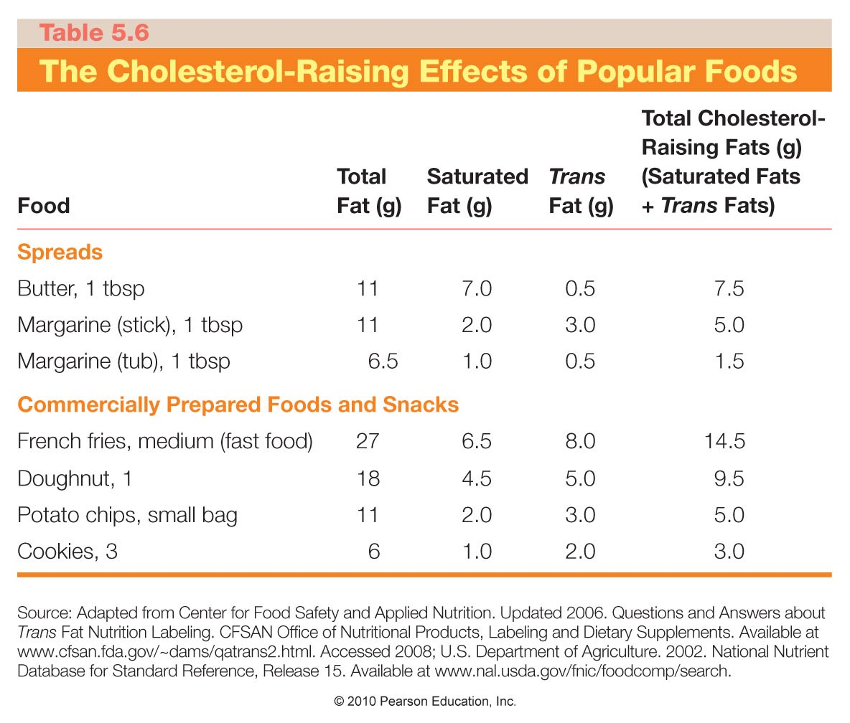

Slide 73
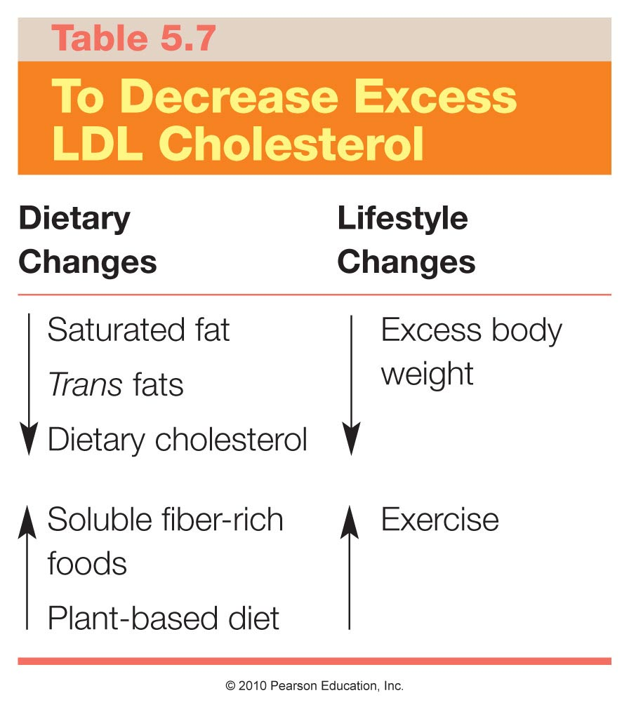

Slide 74
Putting It All Together
For optimal long-term health a diet should include a proper balance of all nutrients including fat
There are different types of lipids, some essential and others not required from foods
Goal
  Consume mostly unsaturated fats
  Limit amount of saturated and trans fats
A plant-based diet plentiful in whole grains, fruits, and vegetables, with some low-fat dairy and lean meats, poultry, fish, and vegetable oil will be high in fiber and lower in saturated fats, trans fats, and dietary cholesterol

Slide 75
Recommendations for
Fat Consumption
Dietary Fat Recommendations
  Less than 30% of calories in diet from fat
  Less than 1/3 of dietary fat should be saturated
Ways to Decrease Intake of Fat
  Minimize "fast" foods
  Minimize processed foods
  Use better cuts of meats
  Use low fat alternatives
  Decrease use of condiments
  Eat lower fat snacks
  Choose foods with “artificial fats”
Notes:
Follow these steps to reduce fat content in the diet.

Slide 76
Recommended Dietary Intake
PRO
PRO (10-15%)
CHO
FAT (30%)
FAT
CHO (55-60%)
Notes:
Recommended levels

Slide 77
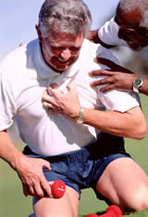
Nutrition and Cardiovascular Disease

Slide 78
Cardiovascular Disease
Symptoms take years to develop
Plaque build-up can begin in childhood
Myocardial infarction (heart attack)
Cerebrovascular accident (stroke)

Slide 79
What Is Heart Disease and What Factors Increase Risk?
Cardiovascular disease is the number-one killer of adults in the United States
Fat and Cholesterol
Accumulate in the arteries
Arteries narrow
Blood flow is impeded
Decrease oxygen and nutrients
Not enough oxygen to the heart
CHEST PAIN

Slide 80
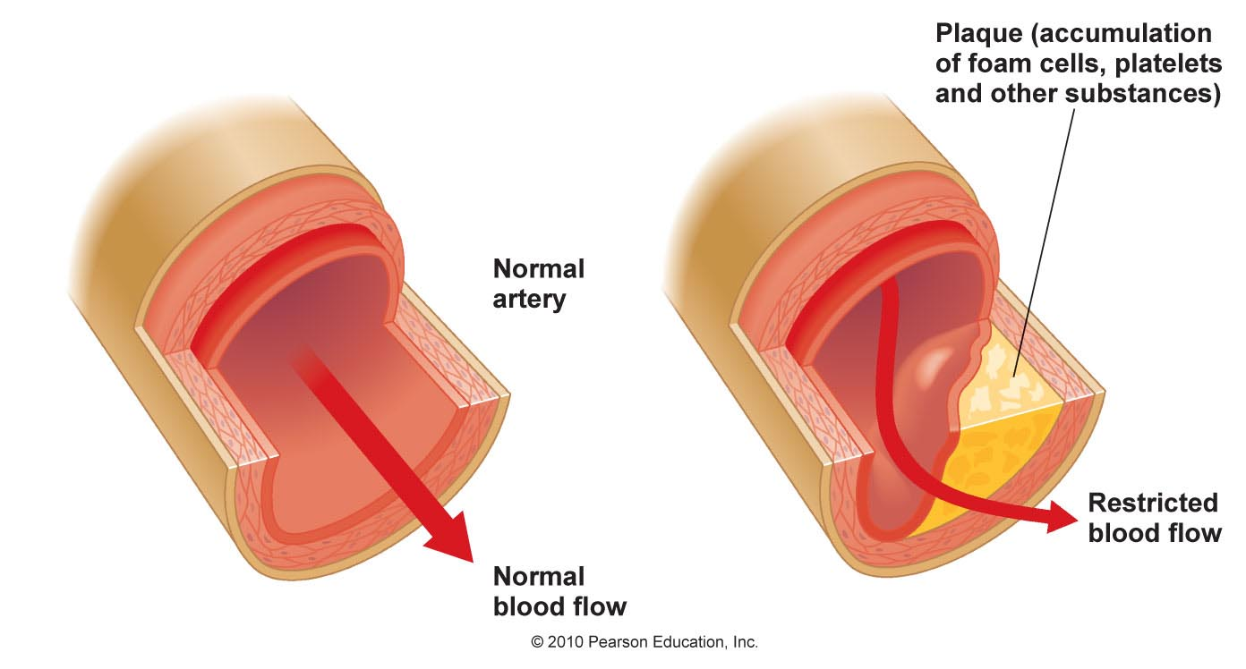
Atherosclerosis
Figure 5.24

Slide 81
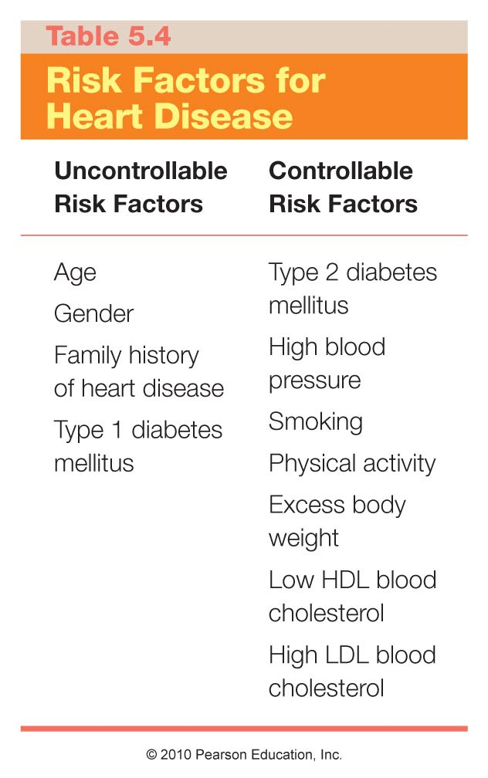

Slide 82
Pathophysiology of Atherosclerosis
Vessel lining is injured (often at branch points) →
Plaque is deposited to repair injured area →
Plaque thickens, incorporating cholesterol, protein, muscle cells, and calcium (rate depends partly on level of LDL-C in the blood) →

Slide 83
Pathophysiology of Atherosclerosis (cont)
Arteries harden and narrow as plaque builds, making them less elastic →
Increasing pressure causes further damage →
A clot or spasm closes the opening, causing a heart attack

Slide 84
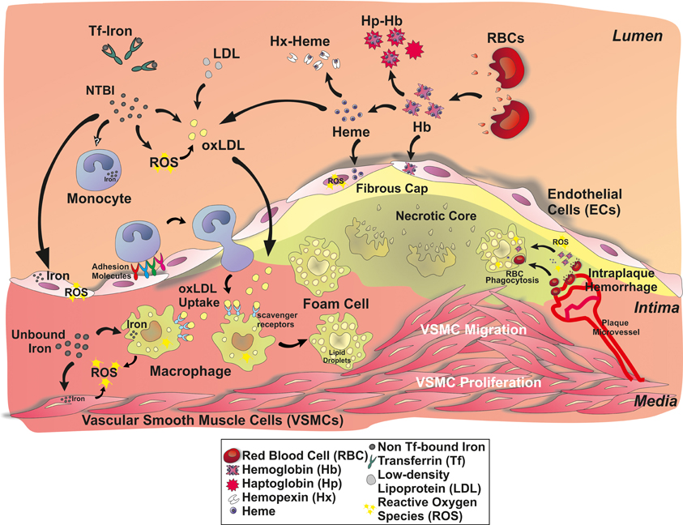

Slide 85
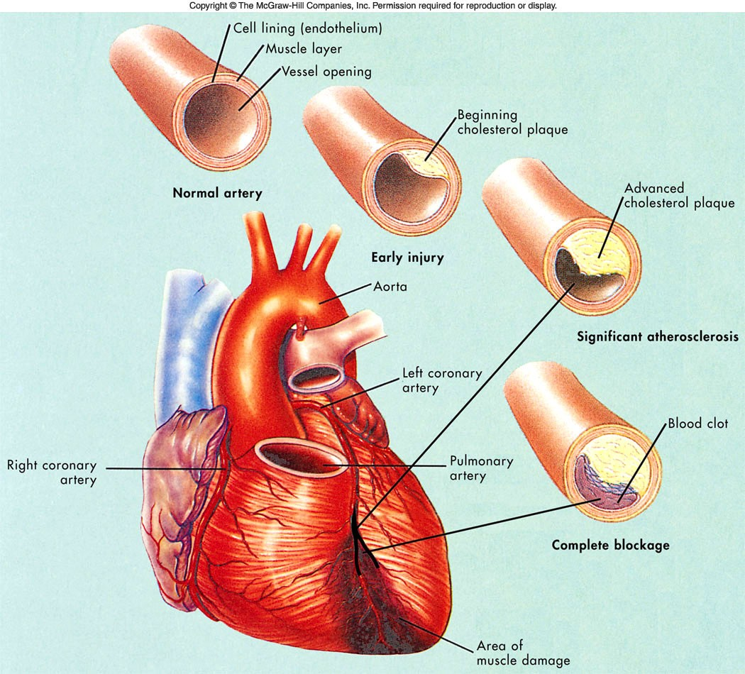
Heart Attack (Myocardial Infarction)

Slide 86
Heart Attack (Myocardial Infarction)
When blood supply to the heart is disrupted, the heart is damaged
May cause the heart to beat irregularly or stop altogether
25% of people do not survive their first heart attack

Slide 87
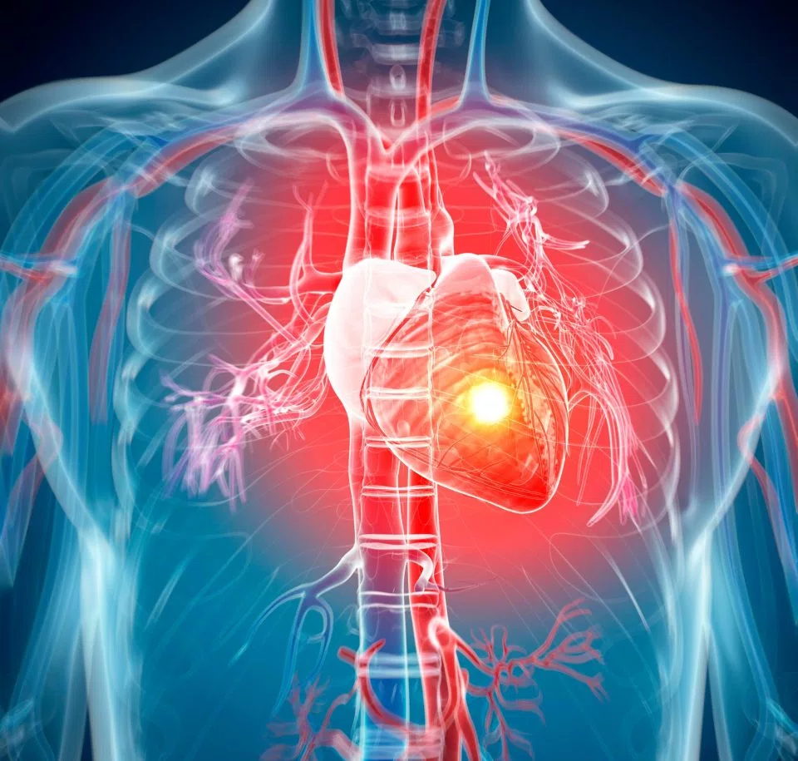
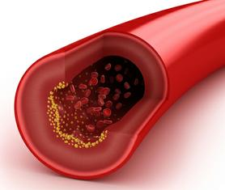
Symptoms of a Heart Attack
Intense, prolonged chest pain or pressure
Shortness of breath
Sweating
Nausea and vomiting (especially women)
Dizziness (especially women)
Weakness
Jaw, neck and shoulder pain (especially women)
Irregular heartbeat

Slide 88
Factors that May Bring On a Heart Attack in At-Risk Persons
Dehydration
Emotional stress
Strenuous physical activity when not physically fit
Waking during the night or getting up in the morning
Eating a large, high-fat meal (increases risk of clotting)

Slide 89
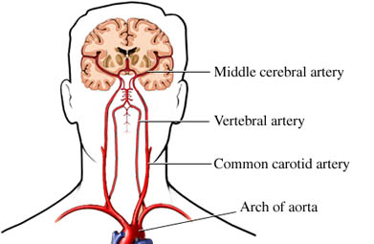
Cerebrovascular Accident (CVA) or Brain Attack

Slide 90
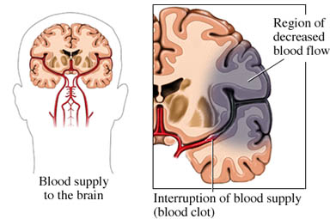
Brain Attack (Stroke) or Cerebrovascular Accident

Slide 91
Symptoms of Stroke (Brain Attack)
Sudden numbness or weakness of the face, arm or leg, especially on one side of the body
Sudden confusion, trouble speaking or understanding
Sudden trouble seeing in one or both eyes
Sudden trouble walking, dizziness, loss of balance or coordination
Sudden severe headache

Slide 92
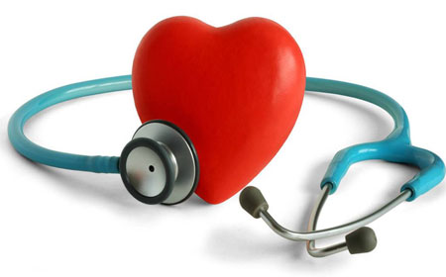
Blood Lipid Levels are Related to Risk of CVD

Slide 93
Blood Lipids (Lipoproteins)
Lipids (fat) cannot mix with water
Blood is high in water
Lipids cannot travel in blood without help
Lipoproteins are formed to carry lipids

Slide 94
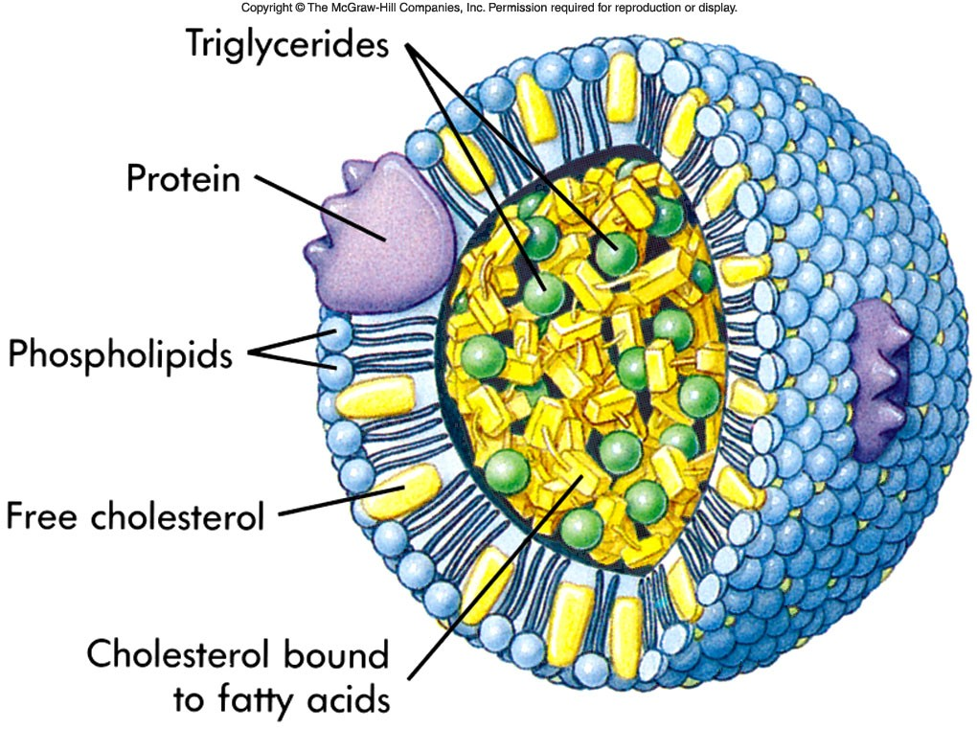
Lipoproteins combine
Lipids (triglycerides, cholesterol)
Protein
Phospholipids

Slide 95
Low-Density Lipoproteins (LDL-C)
Also called “bad cholesterol)
Contain relatively large amounts of fat, and less protein
Deposits cholesterol in arteries
Thus, ↑ LDL-C is associated with ↑ CVD risk
Serum LDL-C should be < 130 mg/dL

Slide 96
High-Density Lipoproteins (HDL)
Also called “good cholesterol”
Relatively high in protein, lower in lipid
Acts as scavenger, carrying cholesterol from arteries to liver
  Liver packages as bile
  Excretes
↑ HDL-C is associated with ↓ risk of CVD
Serum HDL-C should be >60 mg/dL (optimal) or at least >40 in men and 50 in women

Slide 97

Triglycerides
The most diet-responsive blood lipid
Should be ≤150 mg/dL in fasting state

Slide 98
Triglycerides
Lower blood triglycerides by:
Not overeating
Limiting alcohol and simple sugars
Spreading meals throughout the day
Including fatty fish in the diet
Controlling diabetes if present
Performing regular physical activity
Not smoking

Slide 99
Total Cholesterol
Includes HDL-C, LDL-C, and a fraction of the triglycerides
Total cholesterol should be ≤ 200 mg/dL
Total cholesterol does not tell whole story

Slide 100
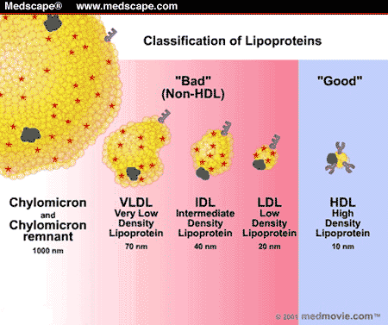
Lipoprotein Summary

Slide 101
Evaluating Blood Lipids: LDL
<100 mg/dL | Optimal
100-129 | Near optimal
130-159 | Borderline high
160-189 | High
≥190 | Very high

Slide 102
Evaluating Blood Lipids: Total Cholesterol
<200 mg/dL | Desirable
200-239 mg/dL | Borderline high
≥240 mg/dL | High

Slide 103
Evaluating Blood Lipids: HDL
< 40 mg/dL | Low
≥ 60 mg/dL | High

Slide 104
Blood Pressure
Measured in mmHg
Systolic blood pressure: the pressure in the arterial blood vessels associated with the pumping of the heart
Diastolic blood pressure: the pressure in the arterial blood vessels when the heart is between beats

Slide 105
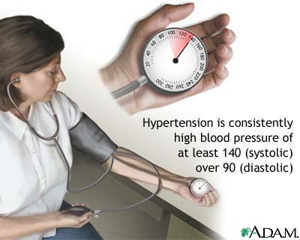
Hypertension: Either
Systolic blood pressure > 140 mmHg
Diastolic blood pressure > 90 mmHg

Slide 106
Risk Factors (other than LDL) for CVD
Cigarette smoking
Hypertension (BP ≥140/90 mmHg or on anti-hypertensive tx
Low HDL-C* (<40 mg/dL)
Family history of premature CHD in first degree relative (in male <55 years, in female <65 years)
Age (men ≥45 years, women ≥55 years)
*HDL-C ≥ 60 mg/dL counts as a negative risk factor

Slide 107
Risk Factors (other than LDL) for CVD
Diabetes (considered equivalent to a history of CHD)
Obesity
Inactivity
Source: ATP-III Guidelines, NHLBI, accessed 2-2005

Slide 108
Screening for CVD Risk
Everyone 20 and older should have his cholesterol measured at least every 5 years
Lipoprotein profile: includes TC, LDL-C HDL-C, and TG
At least should include TC and HDL-C
If TC> 200 mg/dL or HDL-C< 40 mg/dL, obtain full lipid profile

Slide 109
Total Cholesterol
John and Marty each have total cholesterol levels of 200 mg/dL.
Their health risk is different

Slide 110
Total Cholesterol is Not Enough
John’s Lipid Profile
TC: 200 mg/dL
LDL-C: 140 mg/dL
HDL-C: 30 mg/dL
TG: 150 mg/dL
Marty’s Lipid Profile
TC: 200 mg/dl
LDL-C: 95 mg/dL
HDL-C: 75 mg/dL
TG: 150 mg/dL

Slide 111
What Affects Cholesterol Levels?
Diet
Weight
Physical activity
Age and gender
Heredity
You control the first three!

Slide 112
Lowering LDLs
See your doctor to assess for other conditions
Reduce dietary saturated fat, trans fatty acids, and cholesterol
Increase MUFA and PUFA
Increase dietary fiber (soluble)

Slide 113

Lowering Blood TG
Is the most diet-responsive blood lipid
Avoid overeating
Limit alcohol
Limit simple sugars
Small frequent meals
Include fish in the diet

Slide 114
Raise the HDL
Physical activity
At least 45 min./day, 4 days a week
Avoid smoking
Eat regularly
Eat less total fat
Moderate intake of alcohol increases HDL

