Slide 1
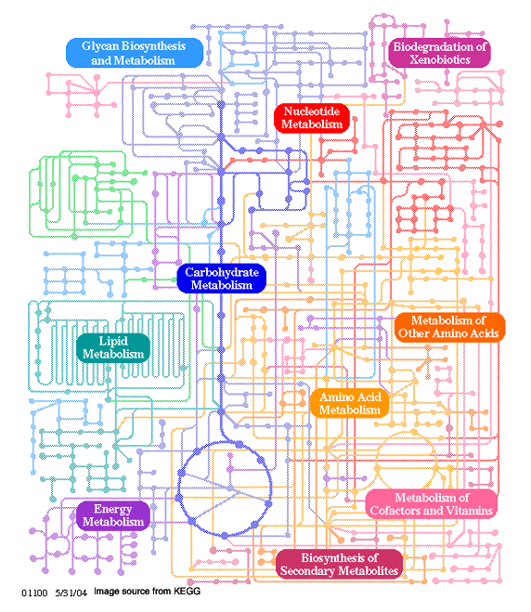
Lesson 5
Protein and amino acid
Metabolism

Slide 2
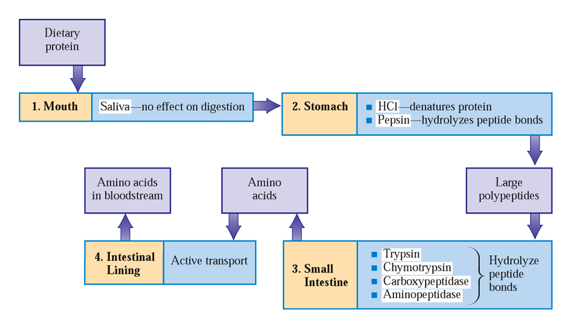
Protein Metabolism

Slide 3
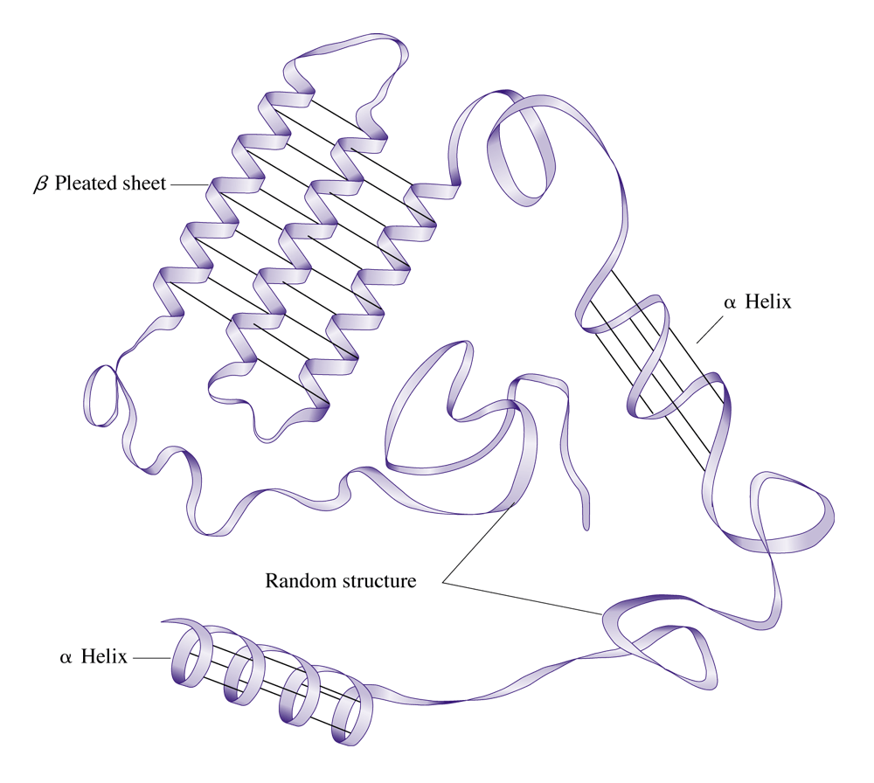
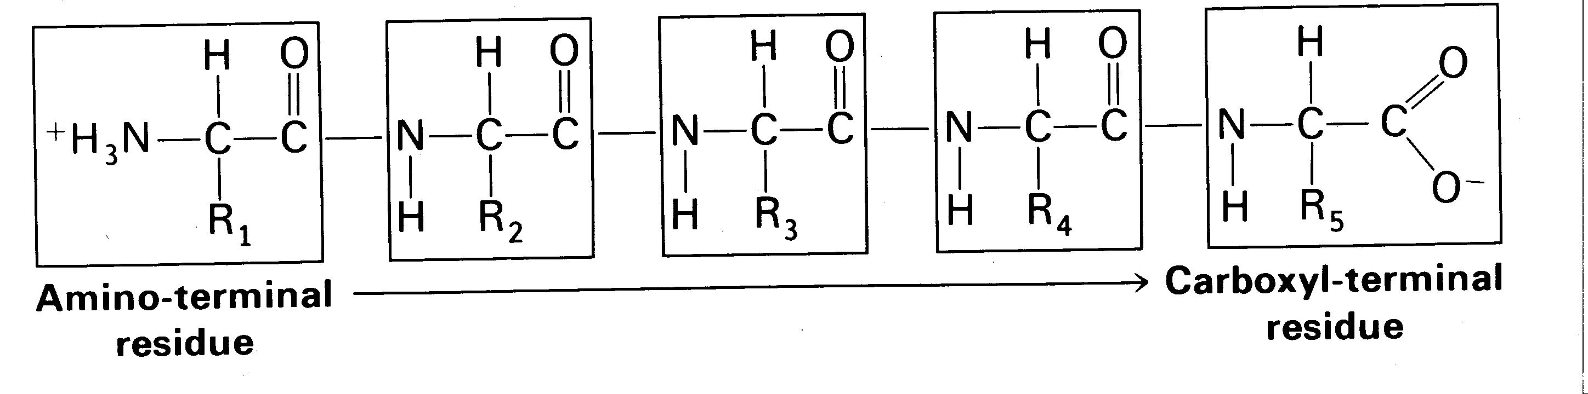
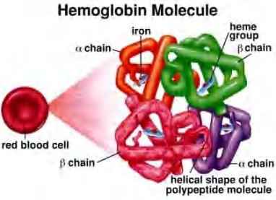
Protein Digestion
Protein breakdown begins in the stomach.
No protein hydrolyzing enzymes are found in saliva.
Hydrolysis (10% of peptide bonds) &
denaturization by pepsin enzyme & HCl acid
produce short chain polypeptides in the
stomach.
Trypsin, chymotrypsin, & carboxypeptidase
from Pancreatic juices,
and Aminopeptidase from cells in the small intestine Brush Zone create “free” amino acids.

Slide 4

Free amino acids are absorbed thru intestinal wall
via active transport.
Enter bloodstream and are brought to cells.
The total supply of free amino acids available is called: the Amino Acid Pool.
3 sources of “free” amino acids:
Dietary protein breakdown
Biosynthesis of amino acids in the Liver
Protein turnover (I prefer apple turnovers)
Protein turnover is the breakdown & re-synthesis
of body protein:
Old tissues
Damage
Recycling enzymes & hormones

Slide 5
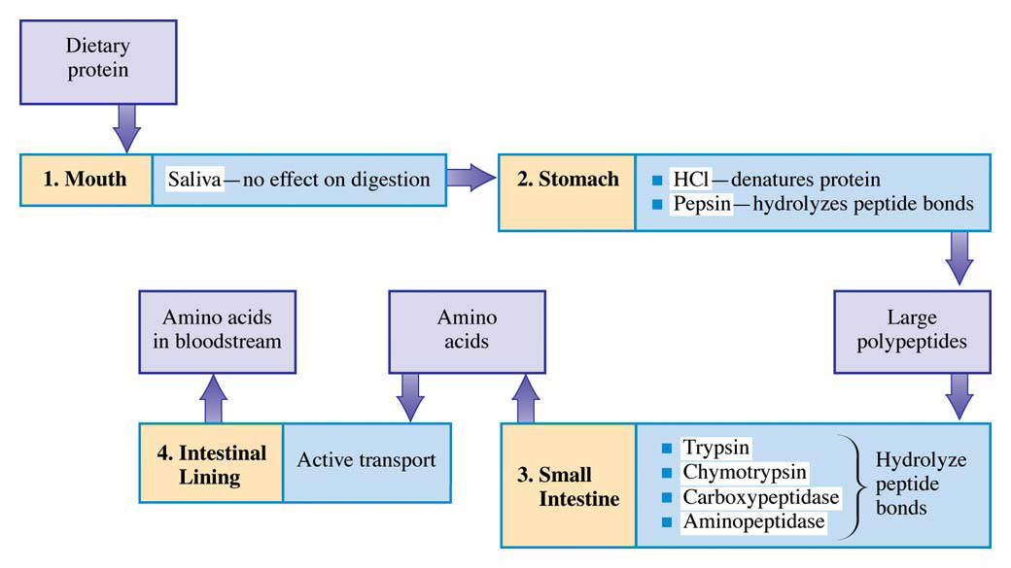
Summary of protein digestion in the human body.Possible fates for amino acid degradation products.

Slide 6
Metabolic relationship of amino acids
BODY PROTEINS
Proteosynthesis
250 – 300
g/day
Degradation
Digestion
NONPROTEIN
DERIVATIVES
Porphyrins
Purines
Pyrimidines
Neurotransmitters
Hormones
Komplex lipids
Aminosugars
AMINO ACIDS
DIETARY
PROTEINS
GLYCOLYSIS
KREBS CYCLE
Transamination
Conversion
(Carbon skeleton)
UREA
NH₃
GLUCOSE
ACETYL CoA
CO₂
KETONBODIES

Slide 7
Transamination and Oxidative Deamination:
Two steps in degrading amino acids
1) remove α-amino group
2) breakdown & process carbon skeleton
Release of an amino group is also two steps:
1) Transamination
2) Oxidative deamination

Slide 8
General reactions of amino acid catabolism
O
+
NH₄⁺
R
C
COO⁻
deamination
O
NH₂
transamination
R
C
COO⁻
R
CH
COO⁻
NH₂
R
CH
COO⁻
oxidative
decarboxylation
NH₃⁺
R
CH₂
+
CO₂

Slide 9
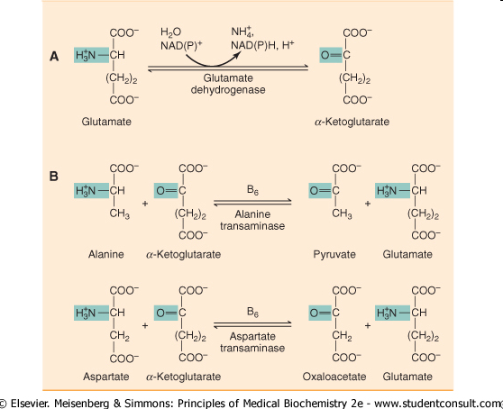
The fate of the amino group during amino acid catabolism

Slide 10
Transamination reaction
The first step in the catabolism of most amino acids is removal of a-amino groups by enzymes transaminases or aminotransferases
All aminotransferases have the same prostethic group and the same reaction mechanism.
The prostethic group is pyridoxal phosphate (PPL), the coenzyme form of pyridoxine (vitamin B₆)

Slide 11
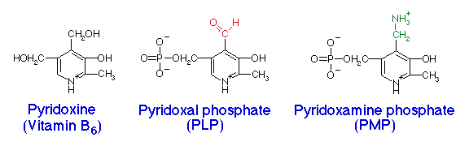
Active metabolic form of vitamin B₆

Slide 12
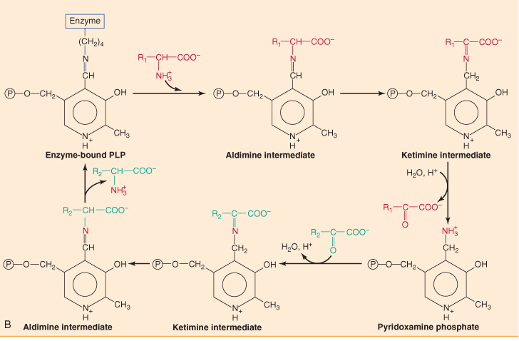
Mechanism of transamination reaction: PPL complex with enzyme accept an amino group to form pyridoxamine phosphate, which can donate its amio group to an α-keto acid.

Slide 13
All amino acids except threonine, lysine, and proline can be transaminated
Transaminases are differ in their specificity for L-amino acids.
The enzymes are named for the amino group donor.

Slide 14
Clinicaly important transaminases
Alanine-α-ketoglutarate transferase ALT
or alanine aminotransferase
(also called serum glutamate-pyruvate transaminase – SGPT)
Aspartate-α-ketoglutarate transferase AST
or aspartate aminotransferase
(also called serum glutamate-oxalacetate transferase – SGOT)
Important in the diagnosis of heart and liver damage caused by heart attack, drug toxicity, or infection.

Slide 15
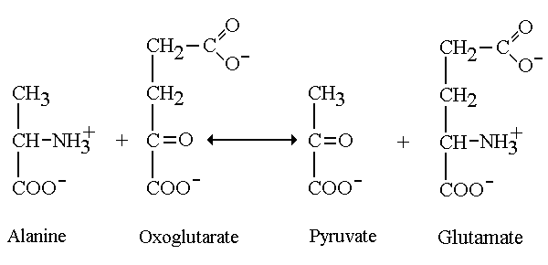
Some transaminases are used for diagnosing disorders:
enzyme alanine aminotransferase
Escapes in large amounts from dead or dying liver tissue.
Measured in blood samples for diagnostic purposes.
ALT
(SGPT)
Notes:
Glutamate:pyruvate transaminase [GPT]
This very active enzyme is also known as alanine aminotransferase and exists in mitochondrial and cytosolic variants. The detailed iso-enzyme pattern is tissue-specific. It escapes in large amounts from dead or dying tissues and GPT may be measured in blood samples for diagnostic purposes. Alanine is the principal amino acid released from muscle tissue during starvation. It is an important substrate for hepatic gluconeogenesis, and alanine transamination is required for the proper maintenance of fasting blood glucose concentrations.

Slide 16
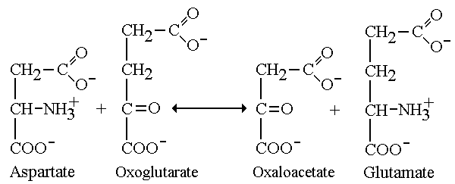
Transaminase enzyme aspartate aminotransferase
very active enzyme inside heart cells.
Also escapes in large amounts from dead or dying heart tissues & enters bloodstream.
Measured in blood for diagnosing myocardial infarction.
AST
(SGOT)
Notes:
Glutamate:oxaloacetate transaminase [GOT]
This enzyme is also known as aspartate aminotransferase and is one of the most active enzymes in the cell. It exists in mitochondrial and cytosolic variants, and the detailed iso-enzyme pattern is tissue-specific. It escapes in large amounts from dead or dying tissues and enters the bloodstream, so GOT is often measured in blood samples for medical diagnostic purposes.
The metabolic importance of this enzyme is that it brings about a free exchange of amino groups between glutamate (which is the most common amino acid) and aspartate which is a second major amino acid pool. Glutamate and aspartate are each required for separate but essential steps in the urea cycle, which is responsible for ammonia detoxication and nitrogen excretion. The free movement of nitrogen between the glutamate and aspartate pools is an important balancing process that is vital for normal cellular metabolism. This reaction is close to equilibrium in both the cytosol and the mitochondrial compartments. It forms an integral part of the malate - asparate shuttle for the "transport" of NADH across the inner mitochondrial membrane.

Slide 17
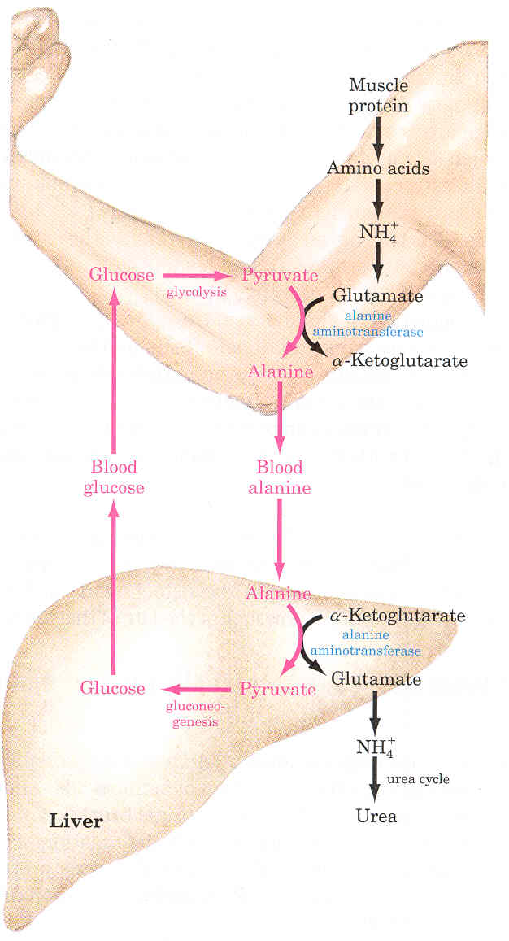
Glucose-alanine cycle
Alanine plays a special role in transporting amino groups to liver.
Ala is the carrier of ammonia and of the carbon skeleton of pyruvate from muscle to liver.
The ammonia is excreted and the pyruvate is used to produce glucose, which is returned to the muscle.
According to D. L. Nelson, M. M. Cox :LEHNINGER. PRINCIPLES OF BIOCHEMISTRY Fifth edition

Slide 18
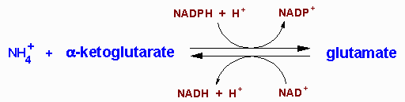
Glutamate releases its amino group as ammonia in the liver
The amino groups from many of the a-amino acids are collected in the liver in the form of the amino group of L-glutamate molecules.
Glutamate undergoes oxidative deamination catalyzed by L-glutamate dehydrogenase.
Enzyme is present in mitochondrial matrix.
It is the only enzyme that can use either NAD⁺ or NADP⁺ as the acceptor of reducing equivalents.
Combine action of an aminotransferase and glutamate dehydrogenase referred to as transdeamination.

Slide 19
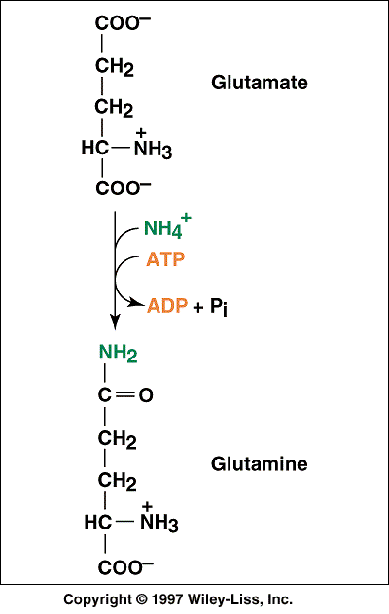
Ammonia transport in the form of glutamine
Excess ammonia is added to glutamate to form glutamine.
Glutamine synthetase
Glutamine enters the liver and NH₄⁺ is liberated in mitochondria by the enzyme glutaminase.
Ammonia is remove by urea synthesis.

Slide 20
Relationship between glutamate, glutamine and α-ketoglutarate
NH₃
E
NH₃
E
α-ketoglutarate
glutamate
glutamine
NH₃
NH₃
E
A. Glutamate dehydrogenase
E
glutamate
+
+
H₂O
+
+
NAD⁺
α-ketoglutarate
NH₃
NADH
From transamination
reactions
To urea cycle
B. Glutamine synthetase (liver)
ATP
ADP
E
glutamate
+
NH₃
glutamine
C. Glutaminase (kidney)
E
glutamine
+
H₂O
glutamate
+
NH₃

Slide 21
Oxidative deamination
A. Oxidative deamination
L-amino acid oxidase produces ammonia and α-keto acid directly, using FMN as cofactor.
The reduced form of flavin must be regenerated by O₂ molecule.
This reaction produces H₂O₂ molecule which is decompensated by catalase.
Amino acids
+
FMN
+
H₂O
E
L-amino acid oxidase
α−keto acids
+
FMNH₂
+
NH₃
O₂
catalse
E
H₂O
+
O₂
FMN
H₂O₂
B. Nonoxidative deamination
Is possible only for hydroxy amino acids
serine
threonine
E
Serin-threonin dehydratase
E
pyruvate
+
NH₃
α-ketoglutate
+
NH₃

Slide 22
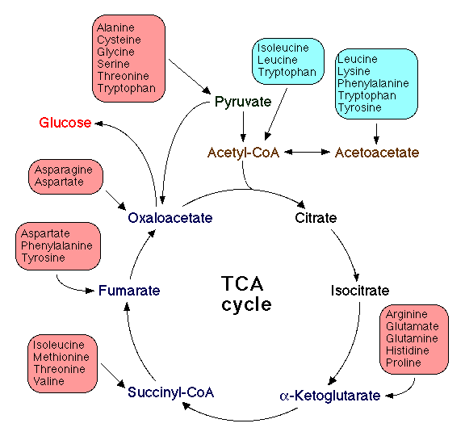
Amino acid metabolism and central metabolic pathways
20 amino acids are converted to 7 products:
pyruvate
acetyl-CoA
acetoacetate
α-ketoglutarate
succynyl-CoA
oxalacetate
fumarate

Slide 23
Glucogenic Amino Acids
formed: α-ketoglutarate, pyruvate, oxaloacetate, fumarate, or succinyl-CoA
Aspartate
Asparagine
Arginine
Phenylalanine
Tyrosine
Isoleucine
Methionine
Valine
Glutamine
Glutamate
Proline
Histidine
Alanine
Serine
Cysteine
Glycine
Threonine
Tryptophan

Slide 24
Ketogenic Amino Acids
formed acetyl CoA or acetoacetate
Lysine
Leucine

Slide 25
Both glucogenic and ketogenic amino acids
formed: α-ketoglutarate, pyruvate, oxaloacetate, fumarate, or succinyl-CoA in addition to acetyl CoA or acetoacetate
Isoleucine
Threonine
Tryptophan
Phenylalanine
Tyrosine

Slide 26




The C3 family: alanine, serine, cysteine and threonine are converted to pyruvate
Alanine
Serine
Pyruvate
Cysteine
Threonine

Slide 27


The C4 family: aspartate and asparagine are converted into oxalacetate
Aspartic acid
Asparagine
Oxalacetate

Slide 28





The C5 family: several amino acids are converted into α-ketoglutarate through glutamate
Glutamine
α−ketoglutarate
Proline
Arginine
Histidine

Slide 29
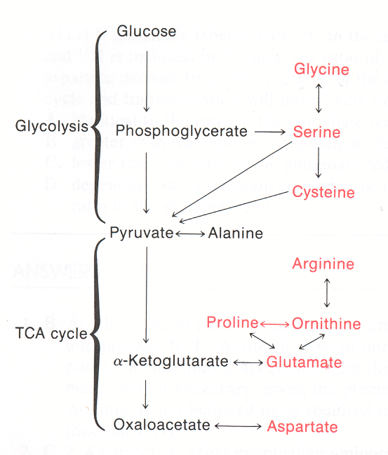
Interconversion of amino acids and intermediates of carbohydrate metabolism and Krebs cycle

Slide 30
Catabolism of branched amino acids
valine
isoleucine
leucine
α-ketoglutarate glutamate (transamination)
α-ketoisovalerate
α-keto-β-methylbutyrate
α-ketoisokaproate
NAD⁺
CO₂
oxidative decarboxylation
Dehydrogenase of α-keto acids*
NADH + H⁺
isobutyryl CoA
α-methylbutyryl CoA
isovaleryl CoA
Dehydrogenation etc., similar to fatty acid β-oxidation
propionyl CoA
acetyl CoA
acetyl CoA
+
+
propionyl CoA
acetoacetate

Slide 31
Branched-chain aminoaciduria
Disease also called Maple Syrup Urine Disease (MSUD) (because of the characteristic odor of the urine in affected individuals).
Deficiency in an enzyme, branched-chain α-keto acid dehydrogenase leads to an accumulation of three branched-chain amino acids and their corresponding branched-chain α-keto acids which are excreted in the urine.
There is only one dehydrogenase enzyme for all three amino acids.
Mental retardation in these cases is extensive.

Slide 32
Histidine Metabolism:
Histamine Formation
Histidine
decarboxylase
Histidine
CO₂
Histamine
Histamine:
Synthesized in and released by mast cells
  Mediator of allergic response: vasodilation, bronchoconstriction

Slide 33
Enzymes which metabolised amino acides containe vitamines as cofactors
THIAMINE B₁ (thiamine diphosphate)
oxidative decarboxylation of α-ketoacids
RIBOFLAVIN B₂ (flavin mononucleotide FMN, flavin adenine dinucleotide FAD)
oxidses of α-aminoacids
NIACIN B₃ – nicotinic acid (nikotinamide adenine dinucleotide NAD⁺
nikotinamide adenine dinukleotide phosphate NADP⁺)
dehydrogenases, reductase
PYRIDOXIN B₆ (pyridoxalphosphate)
transamination reaction and decarboxylation
FOLIC ACID (tetrahydropholate)
Meny enzymes of amino acid metabolism

Slide 34

Urea cycle:
Ammonium salts (NH₄⁺) are toxic compounds.
Oxidative deamination converting glutamate to
α-ketoglutarate is an easily shifted equilibrium reaction.
Ammonium ions building up favors the synthesis of excessive amounts of glutamate, decreasing the Krebs cycle intermediate α-ketoglutarate.
This in turn decreases ATP production, and that affects the nervous system.
The answer is Urea:
Notes:
Urea cycle:
Ammonium ions are in equilibrium with about 1% free ammonia at physiological pH. Ammonium salts are toxic compounds, causing vomiting, convulsions and ultimately coma and death when the blood concentration exceeds approximately 0.25mM. It is not entirely clear why this should be so: it may be that ammonium ions mimic potassium ions, but uncharged ammonia gas can gain access to areas from which ions should be excluded. Alternatively, they may favour the synthesis of excessive amounts of glutamate and glutamine which have excitatory effects on neural tissues.

Slide 35
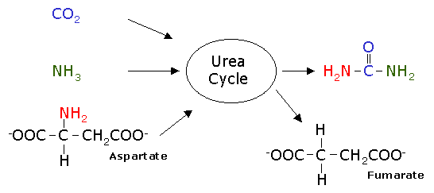
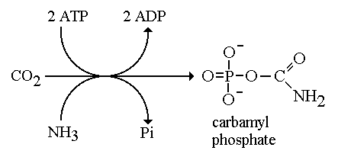
The inputs to the urea cycle are
NH₃, CO₂ and aspartic acid and ATP.
The outputs are urea, ADP and fumaric acid.
The carbonyl group of urea is derived from CO₂
Ammonia contributes one of the amine groups on urea

Slide 36
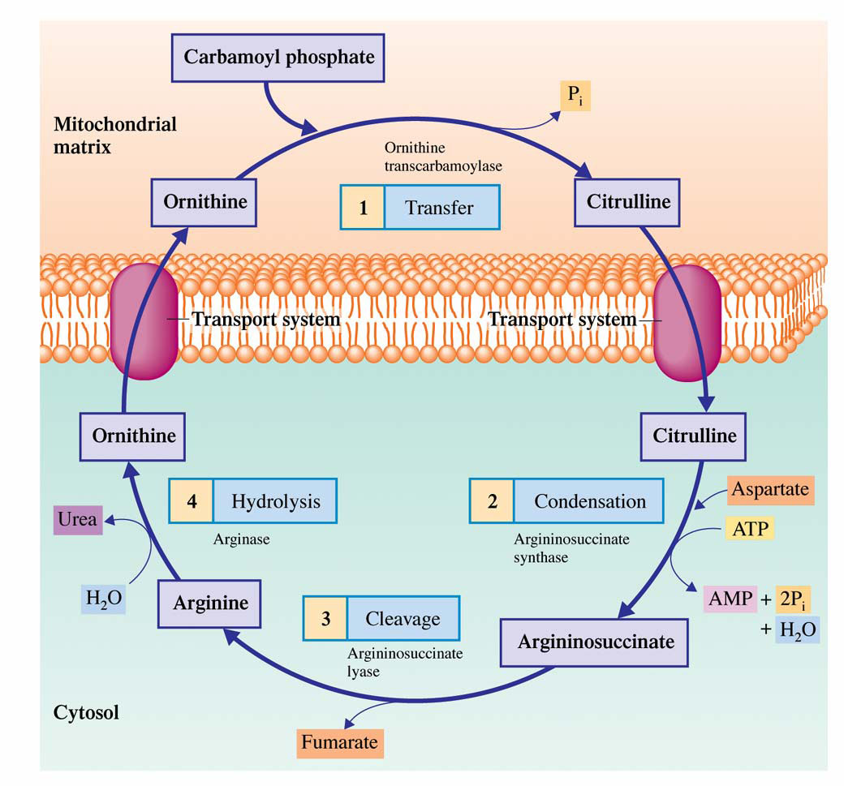
The four-step urea cycle in which carbamoyl phosphate is converted to urea.

Slide 37
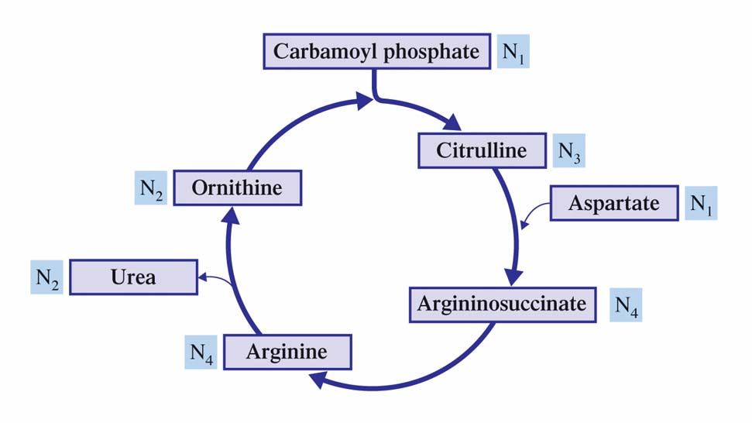
The nitrogen content of the various compounds that participate in the urea cycle.
Does it remind you of the Krebs cycle in any way?

Slide 38
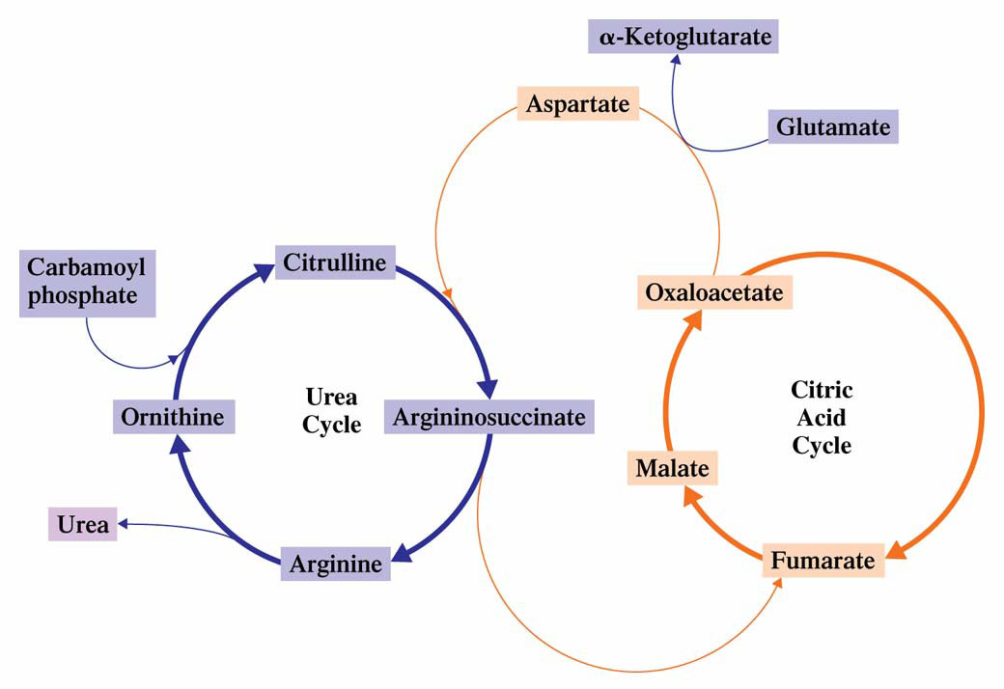
Fumarate from the urea cycle enters the Krebs cycle. Aspartate produced from oxaloacetate of the Krebs cycle enters the urea cycle.
Oxaloacetate has 4 potential fates: transamination; conversion to glucose; formation of citrate; conversion to pyruvate

Slide 39
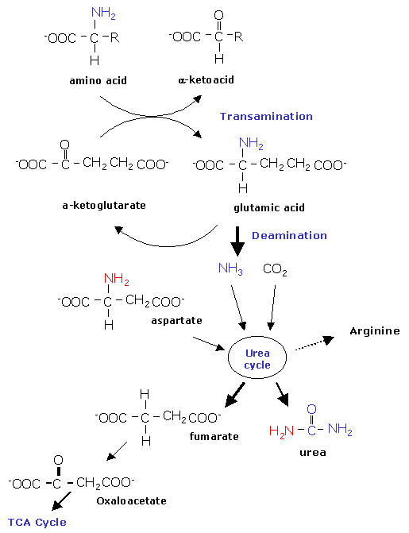
Summary:
Transamination takes off amine groups from amino acids and forms glutamate
(ionized glutamic acid)
Amine groups form ammonia when removed in deamination
This combines with CO₂ & Aspartate.
Forms urea, Arginine,
& Fumarate

Slide 40
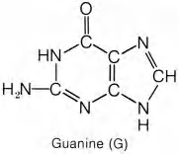
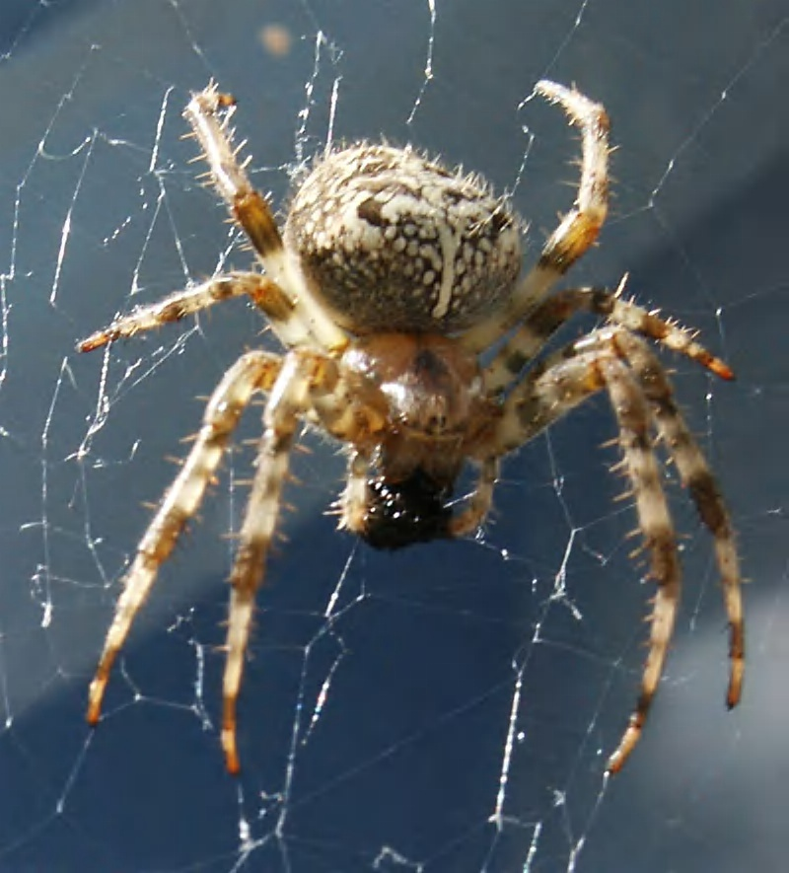
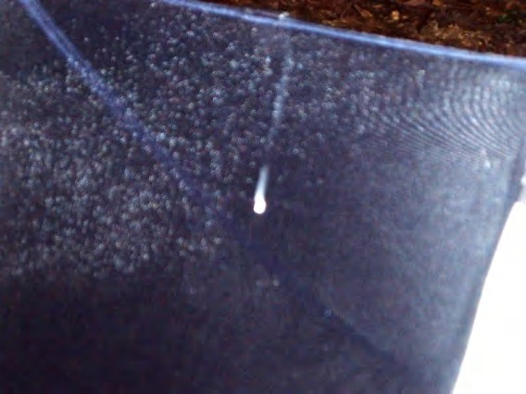
Alternative methods of nitrogen excretion
Aquatic species excrete free ammonia through gills.
Terrestrial critters produce Urea - very soluble - still needs water for removal via kidneys.
Imposes a minimum daily water requirement.
Spiders excrete guanine,
5 nitrogen atoms in a small molecule.
Notes:
Alternative methods of nitrogen excretion
It is therefore necessary to have an efficient means to remove ammonia from the body. Water-living species commonly excrete free ammonia through their gills [ammonotelism], but this easy option is not available to land dwellers which produce a variety of less toxic nitrogenous end products. Urea synthesis and excretion [ureotelism] first evolved in sharks, lungfish and primitive amphibia about 400 million years ago. The process is replicated today when ammonotelic tadpoles leave the water and metamorphose into ureotelic frogs. Urea is also used in humans, and in all placental mammals, which start to express the urea cycle genes around the time of birth. Urea is very soluble, but still requires appreciable quantities of water for its removal via the kidneys. This imposes a minimum daily water requirement and limits the range of environments that these ureotelic species can exploit.
Urea is not the only possible solution to the problem: spiders excrete guanine, which packs no less than 5 surplus nitrogen atoms into a single small molecule, while reptiles and birds excrete mainly uric acid [uricotelism]. Uric acid is an extremely insoluble purine compound that readily forms supersaturated solutions. This has been turned to advantage in uricotelic species, which can survive in extremely arid environments. They regurgitate concentrated urine, supersaturated with uric acid, from the cloaca into the hindgut where the uric acid crystalises and the residual water is resorbed. The uric acid forms the fine pasty mass of white crystals that is familiar to us in bird droppings.
Uricotelism is also an advantage to animals that lay shelled eggs, which of necessity have a zero water intake. The uric acid crystalises within the allantois, part of which eventually becomes incorporated into the lower gut as the embryo develops. In humans the insolubility of uric acid is a considerable nuisance, since it gives rise to the extremely painful deposits of small crystals [called "tophi"] within the joints of patients suffering from gout.
Urea is synthesised via the urea cycle, which is confined to mammalian liver. Individual enzymes from the urea cycle are present in other tissues, and may be important for arginine biosynthesis, but the complete cycle does not occur. Extra-hepatic tissues export their surplus nitrogen to the liver by other routes, principally as the amino acids alanine and glutamine. In addition, the cleavage of arginine by nitric oxide synthetase generates citrulline, which is a urea cycle intermediate. Citrulline is recycled to arginine, and in tissues which use the nitric oxide signalling system the relevant urea cycle enzymes have sufficient activity to maintain cellular arginine supplies.

Slide 41
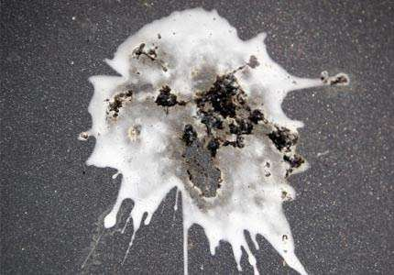
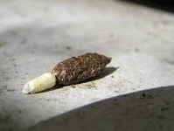
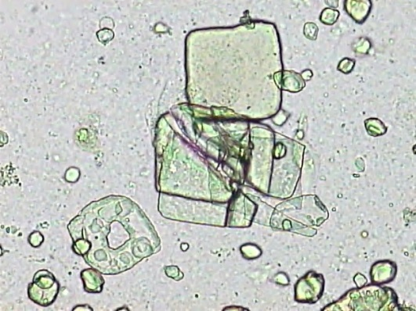
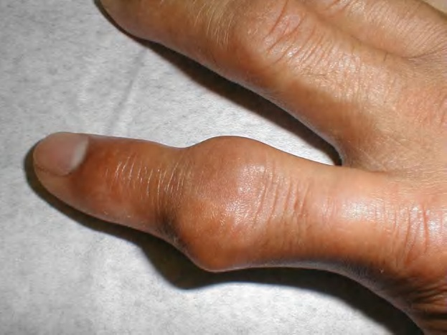
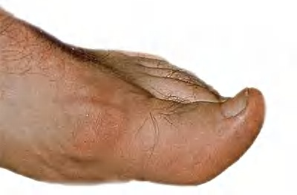
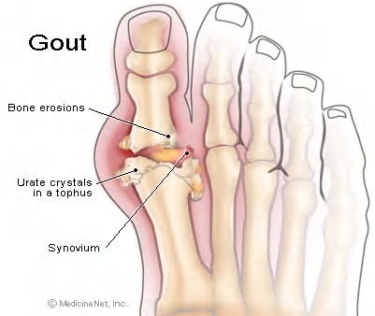
Reptiles & birds excrete uric acid – very insoluble purine compound – forms supersaturated solutions.
Concentrated urine, supersaturated with uric acid,
goes from cloaca into hindgut –
uric acid crystalizes & water is reabsorbed.
In humans uric acid deposits crystals & causes gout.
Notes:
Urea cycle:
Ammonium ions are in equilibrium with about 1% free ammonia at physiological pH. Ammonium salts are toxic compounds, causing vomiting, convulsions and ultimately coma and death when the blood concentration exceeds approximately 0.25mM. It is not entirely clear why this should be so: it may be that ammonium ions mimic potassium ions, but uncharged ammonia gas can gain access to areas from which ions should be excluded. Alternatively, they may favour the synthesis of excessive amounts of glutamate and glutamine which have excitatory effects on neural tissues.

Slide 42
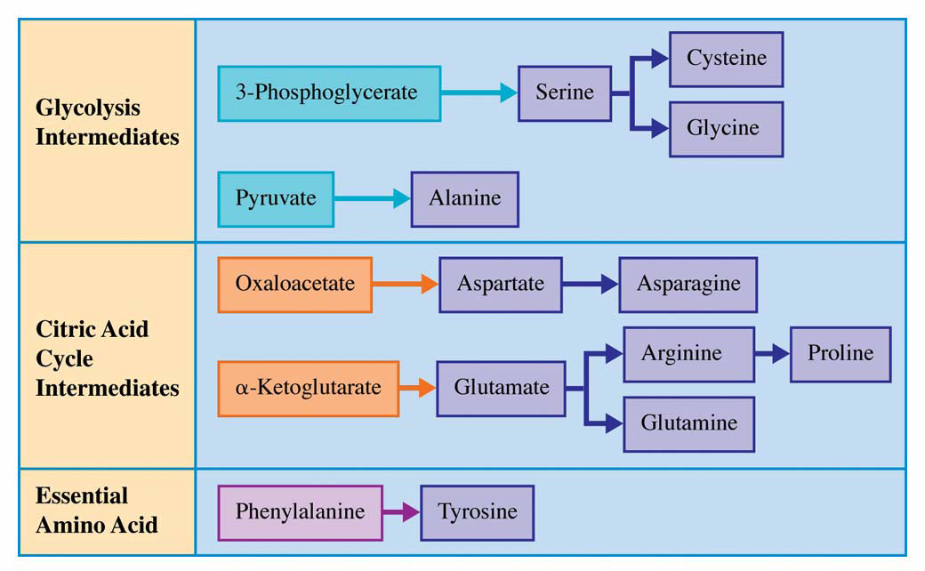
Starting materials for biosynthesis of
11 nonessential amino acids: 1 step, 2 steps, or 3 steps
Alanine, aspartate, & glutamate use transamination

Slide 43
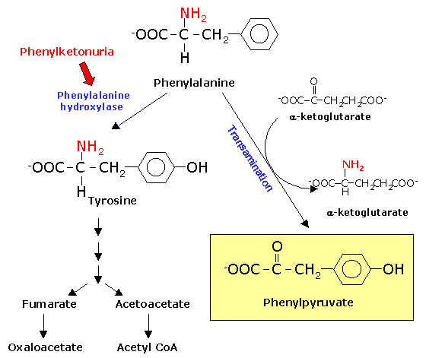
Phenylalanine & tyrosine degradation:
Degradation of phenylalanine starts with conversion to tyrosine
catalyzed by
phenylalanine hydroxylase.
Fumarate & acetoacetate
are formed.
Fumarate is converted
to oxaloacetate
for TCA cycle
& acetoacetate is
converted to acetyl CoA.
Notes:
Uricotelism is also an advantage to animals that lay shelled eggs, which of necessity have a zero water intake. The uric acid crystalises within the allantois, part of which eventually becomes incorporated into the lower gut as the embryo develops. In humans the insolubility of uric acid is a considerable nuisance, since it gives rise to the extremely painful deposits of small crystals [called "tophi"] within the joints of patients suffering from gout.

Slide 44
Phenylketonuria
Hyperphenylalaninemia - complete deficiency of phenylalanine hydroxylase (plasma level of Phe raises from normal 0.5 to 2 mg/dL to more than 20 mg/dL).
The mental retardation is caused by the accumulation of phenylalanine, which becomes a major donor of amino groups in aminotransferase activity and depletes neural tissue of α-ketoglutarate.
Absence of α-ketoglutarate in the brain shuts down the TCA cycle and the associated production of aerobic energy, which is essential to normal brain development.
Newborns are routinelly tested for blood concentration of Phe.
The diet with low-phenylalanine diet.

Slide 45
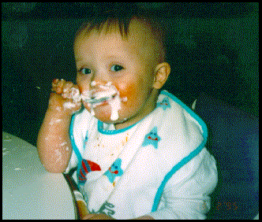
Phenylketonuria (PKU):
Defective phenylalanine hydroxylase –
phenylalanine accumulates in body.
Phenylalanine is transaminated to phenylpyruvate.
Accumulation of phenylpyruvate leads to severe mental retardation in infants.
Persons suffering from phenylketonuria should not consume foods containing high levels of phenylalanine, such as aspartame.
Notes:
Urea is not the only possible solution to the problem: spiders excrete guanine, which packs no less than 5 surplus nitrogen atoms into a single small molecule, while reptiles and birds excrete mainly uric acid [uricotelism]. Uric acid is an extremely insoluble purine compound that readily forms supersaturated solutions. This has been turned to advantage in uricotelic species, which can survive in extremely arid environments. They regurgitate concentrated urine, supersaturated with uric acid, from the cloaca into the hindgut where the uric acid crystalises and the residual water is resorbed. The uric acid forms the fine pasty mass of white crystals that is familiar to us in bird droppings.

Slide 46
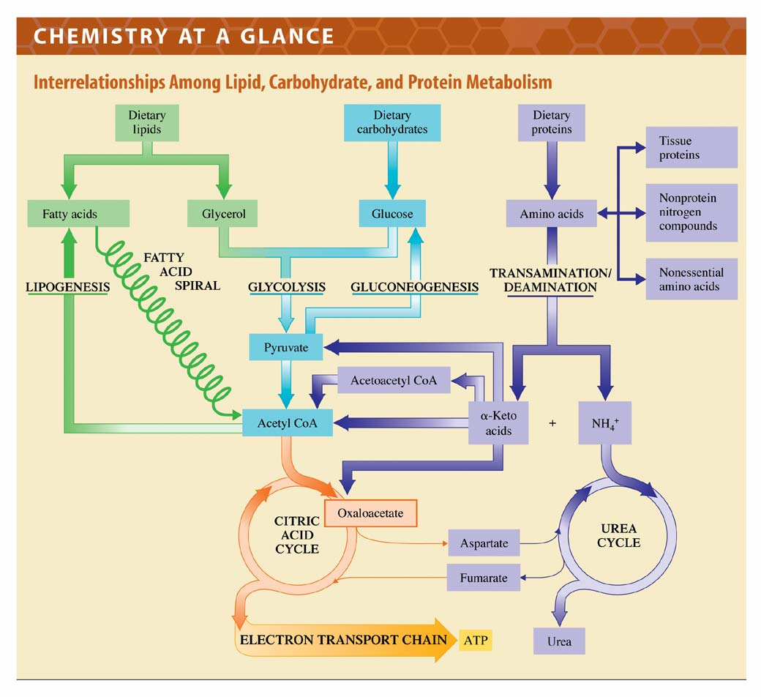
Follow each pathway to its various products.
All are highly inter-related.

