Slide 1
Lesson 3 (Part-II)
Carbohydrate Metabolism

Slide 2
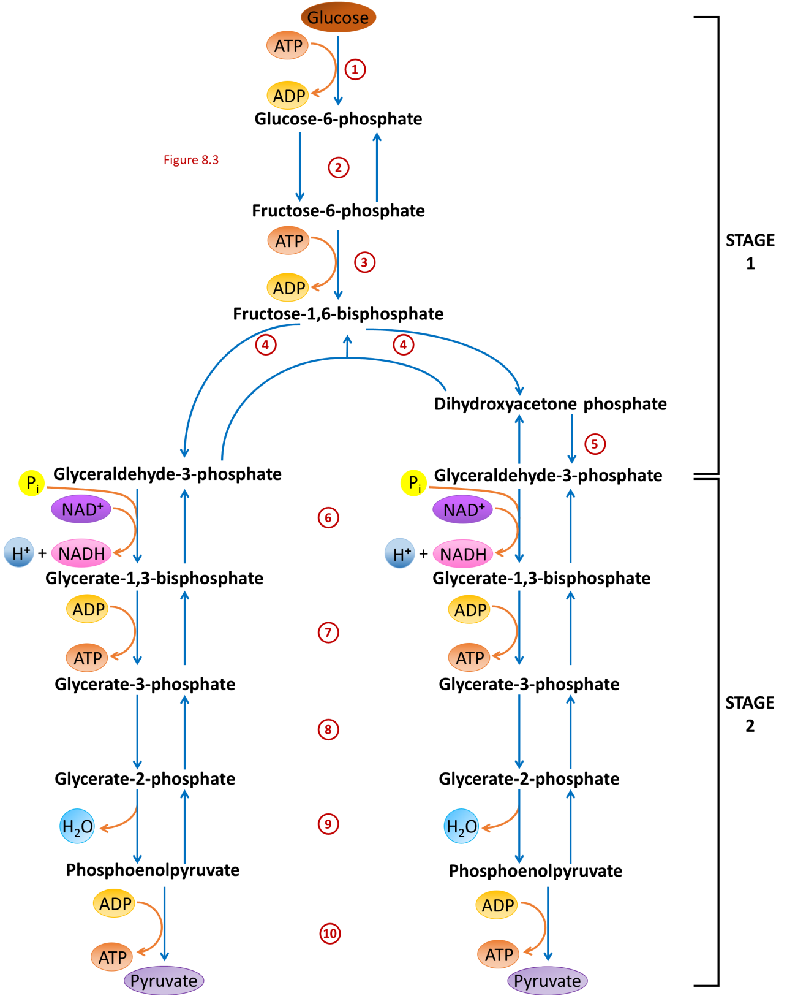

Slide 3
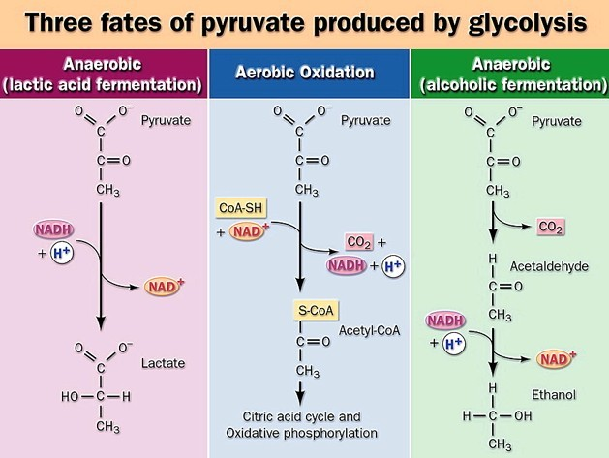
FATE OF PYRUVATE MADE FROM GLYCOLYSIS

Slide 4
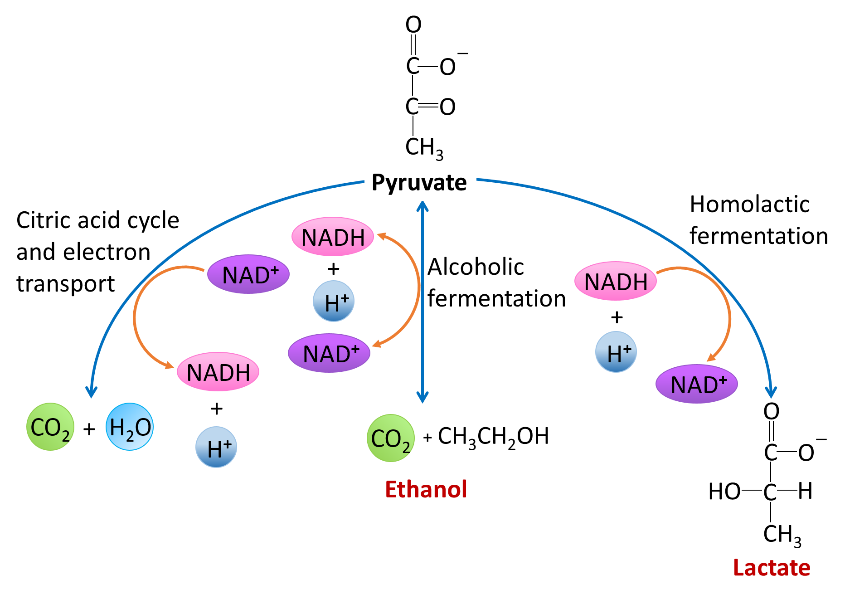
FATE OF PYRUVATE MADE FROM GLYCOLYSIS

Slide 5
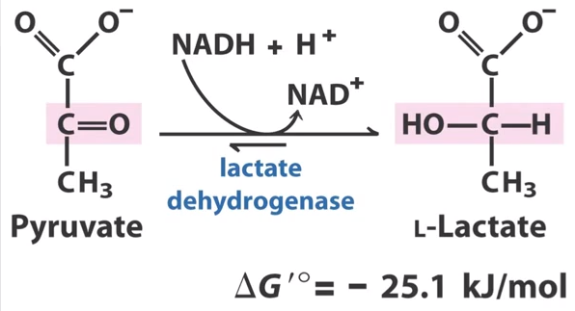
Lactic acid fermentation occurs in muscle cells when oxygen is in low supply.

Slide 6
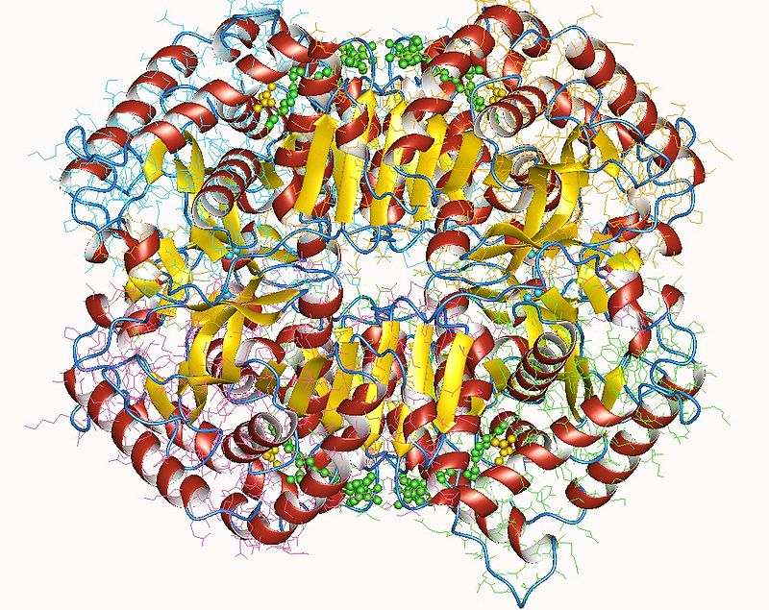
Human Lactate dehydrogenase tetramer
LDH-5 (4M) —in the liver and striated muscle

Slide 7
GLUCONEOGENESIS
Formation of glucose from
non-carbohydrate sources

Slide 8
The source of pyruvate and oxaloacetate for gluconeogenesis during fasting or carbohydrate starvation is mainly amino acid catabolism.
Some amino acids are catabolized to pyruvate, oxaloacetate, or precursors of these.
Muscle proteins may break down to supply amino acids. These are transported to liver where they are de-aminated and converted to gluconeogenesis inputs.
Glycerol, derived from hydrolysis of triacylglycerol in fat cells, is also a significant input to gluconeogenesis.

Slide 9
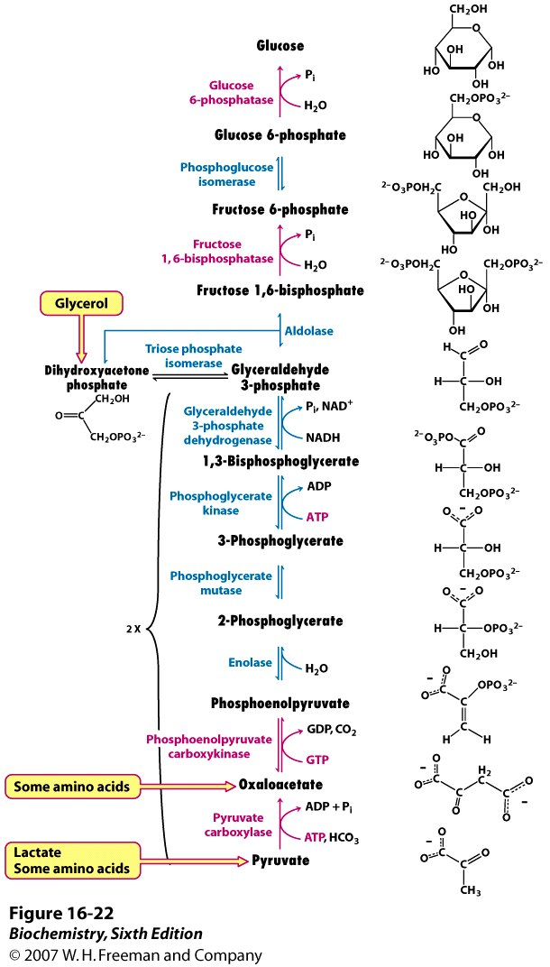
Non-carbohydrate
precursors of glucose
Triglycerols
Fatty acids
glycerol
Dietary & muscle
proteins
Amino acids

Slide 10
Main sites of gluconeogenesis:
Major site: Liver.
Minor site: Kidney.
Very little:
Brain.
Muscle (skeletal and heart).
In liver and kidney it helps to maintain the glucose level in the blood so that brain and muscle can extract sufficient glucose from it to meet their metabolic demands.

Slide 11
Gluconeogenesis Versus Glycolysis:
7 steps are shared between glycolysis and gluconeogenesis.
3 essentially irreversible steps shift the equilibrium far on the side of glycolysis.
Most of the decrease in free energy (consuming energy) in glycolysis takes place during these 3 steps.

Slide 12
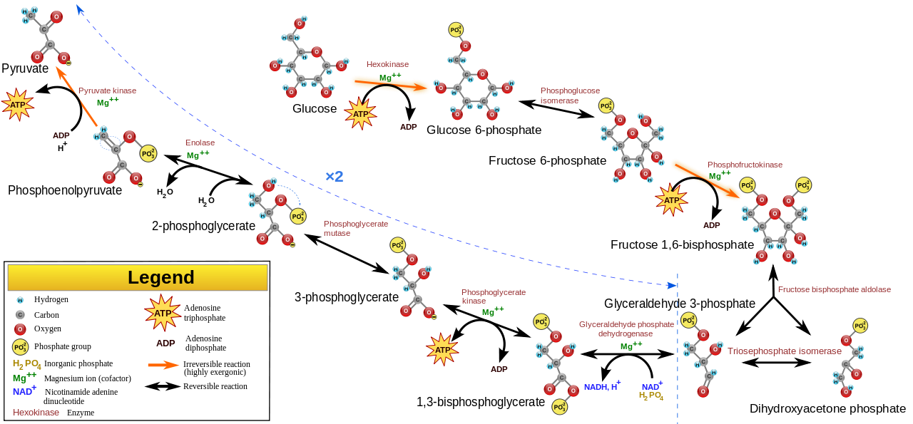
Glycolysis

Slide 14
In gluconeogenesis the three reactions are bypassed by a set of separate enzymes.
1. Phosphoenolpyruvate is formed from pyruvate:
2. Fructose 6-phosphate is formed from fructose 1,6-bisphosphate:
3. Glucose is formed by hydrolysis of glucose 6-phosphate:

Slide 15
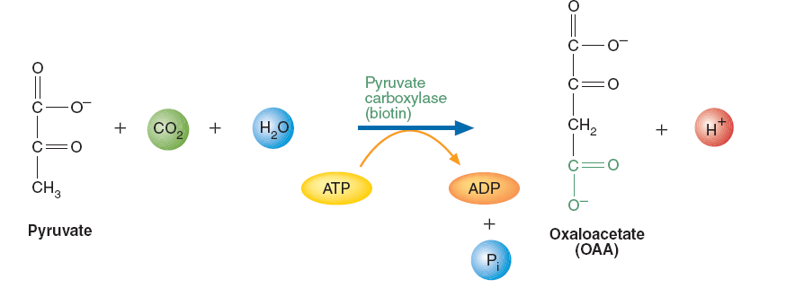
Gluconeogenesis Reactions
1. Synthesis of PEP. PEP synthesis from pyruvate requires two enzymes: pyruvate carboxylase and PEP carboxykinase. Pyruvate carboxylase, found within mitochondria, converts pyruvate to oxaloacetate (OAA):
The transfer of CO2 to form the product OAA is mediated by the coenzyme biotin, which is covalently bound within the enzyme’s active site.

Slide 16
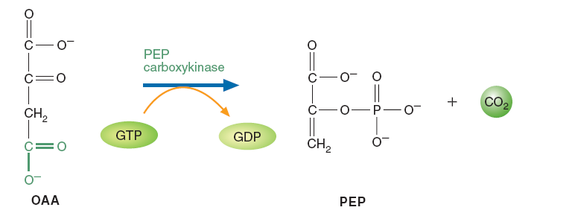
OAA is then decarboxylated and phosphorylated by PEP car boxykinase in a reaction driven by the hydrolysis of guanosine triphosphate (GTP):

Slide 17
PYRUVATE PHOSPHOENOLPYRUVATE
2 Enzymes needed to bypass pyruvate kinase
A
B

Slide 18
Cytosolic PEP CARBOXYKINASE
Oxaloacetate
PEP
Cytosolic Malate DEHYDROGENASE
NADH
+ H⁺
NAD⁺
CO₂
Malate
Malate
NAD⁺
H⁺+
NADH
Oxaloacetate
Pyruvate CARBOXYLASE
CO₂
Pyruvate
The malate shuttle allows gluconeogenesis to continue
because it provides the NADH required for the reaction catalyzed
by glyceraldehyde-3-phosphate dehydrogenase
Pyruvate

Slide 19
Cytosolic PEP CARBOXYKINASE
Oxaloacetate
PEP
Cytosolic Malate DEHYDROGENASE
NADH
+ H⁺
NAD⁺
CO₂
Malate
PEP
Malate
Mitochondrial PEP CARBOXYKINASE
NAD⁺
CO₂
H⁺+
NADH
Oxaloacetate
Oxaloacetate
Pyruvate CARBOXYLASE
Pyruvate CARBOXYLASE
CO₂
CO₂
Pyruvate
Pyruvate
Pyruvate
NADH
+ H⁺
Pyruvate
NAD⁺
Lactate DEHYDROGENASE
Lactate

Slide 20
2. Conversion of fructose-1,6-bisphosphate to fructose-6-phosphate. The irreversible PFK-1–catalyzed reaction in glycolysis is bypassed by fructose-1,6-bisphosphatase:
This exergonic reaction (∆G◦’ –16.7 kJ/mol) is also irreversible under cellular conditions. ATP is not regenerated, and inorganic phosphate (Pi) is also produced.

Slide 21
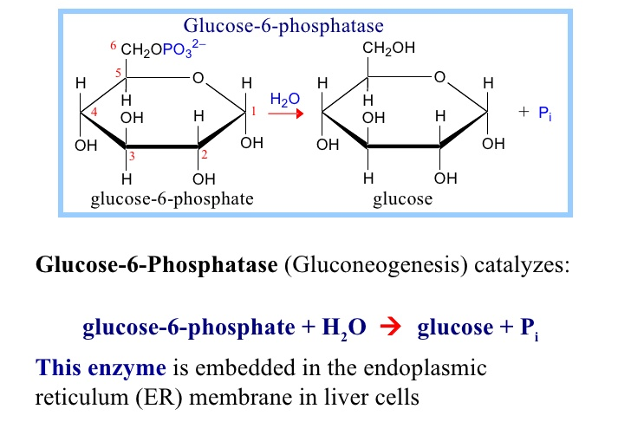
3. Formation of glucose from glucose-6-phosphate. Glucose-6-phosphatase, found only in liver and kidney, catalyzes the irreversible hydrolysis of glucose-6-phosphate to form glucose and Pi. Glucose is subsequently released into the blood.

Slide 22
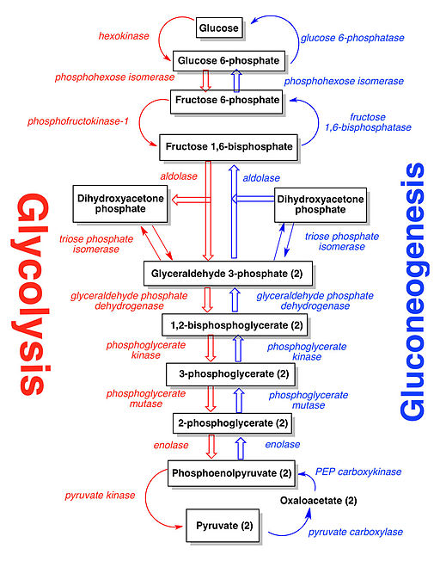

Slide 23
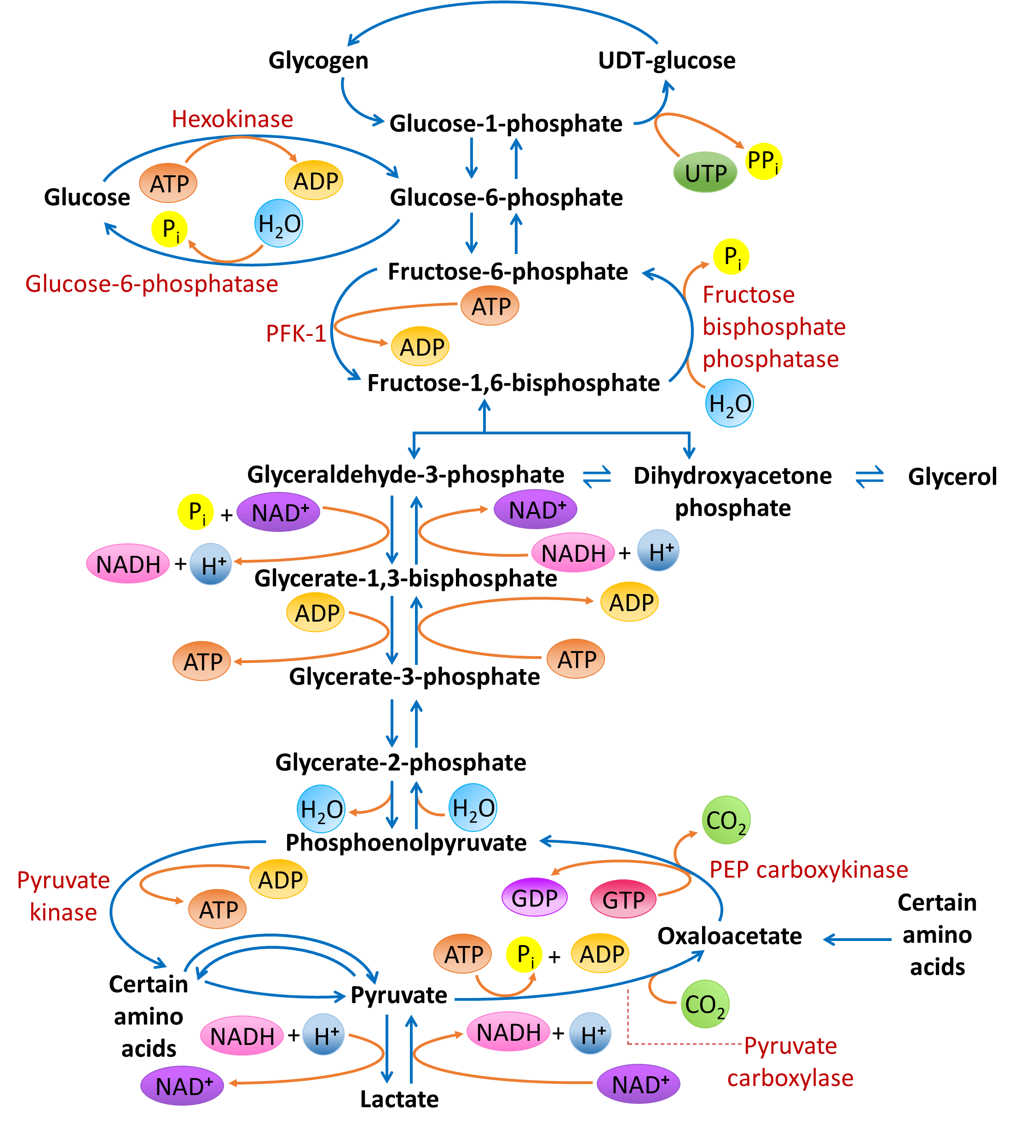
Glycolysis and Gluconeogenesis

Slide 24
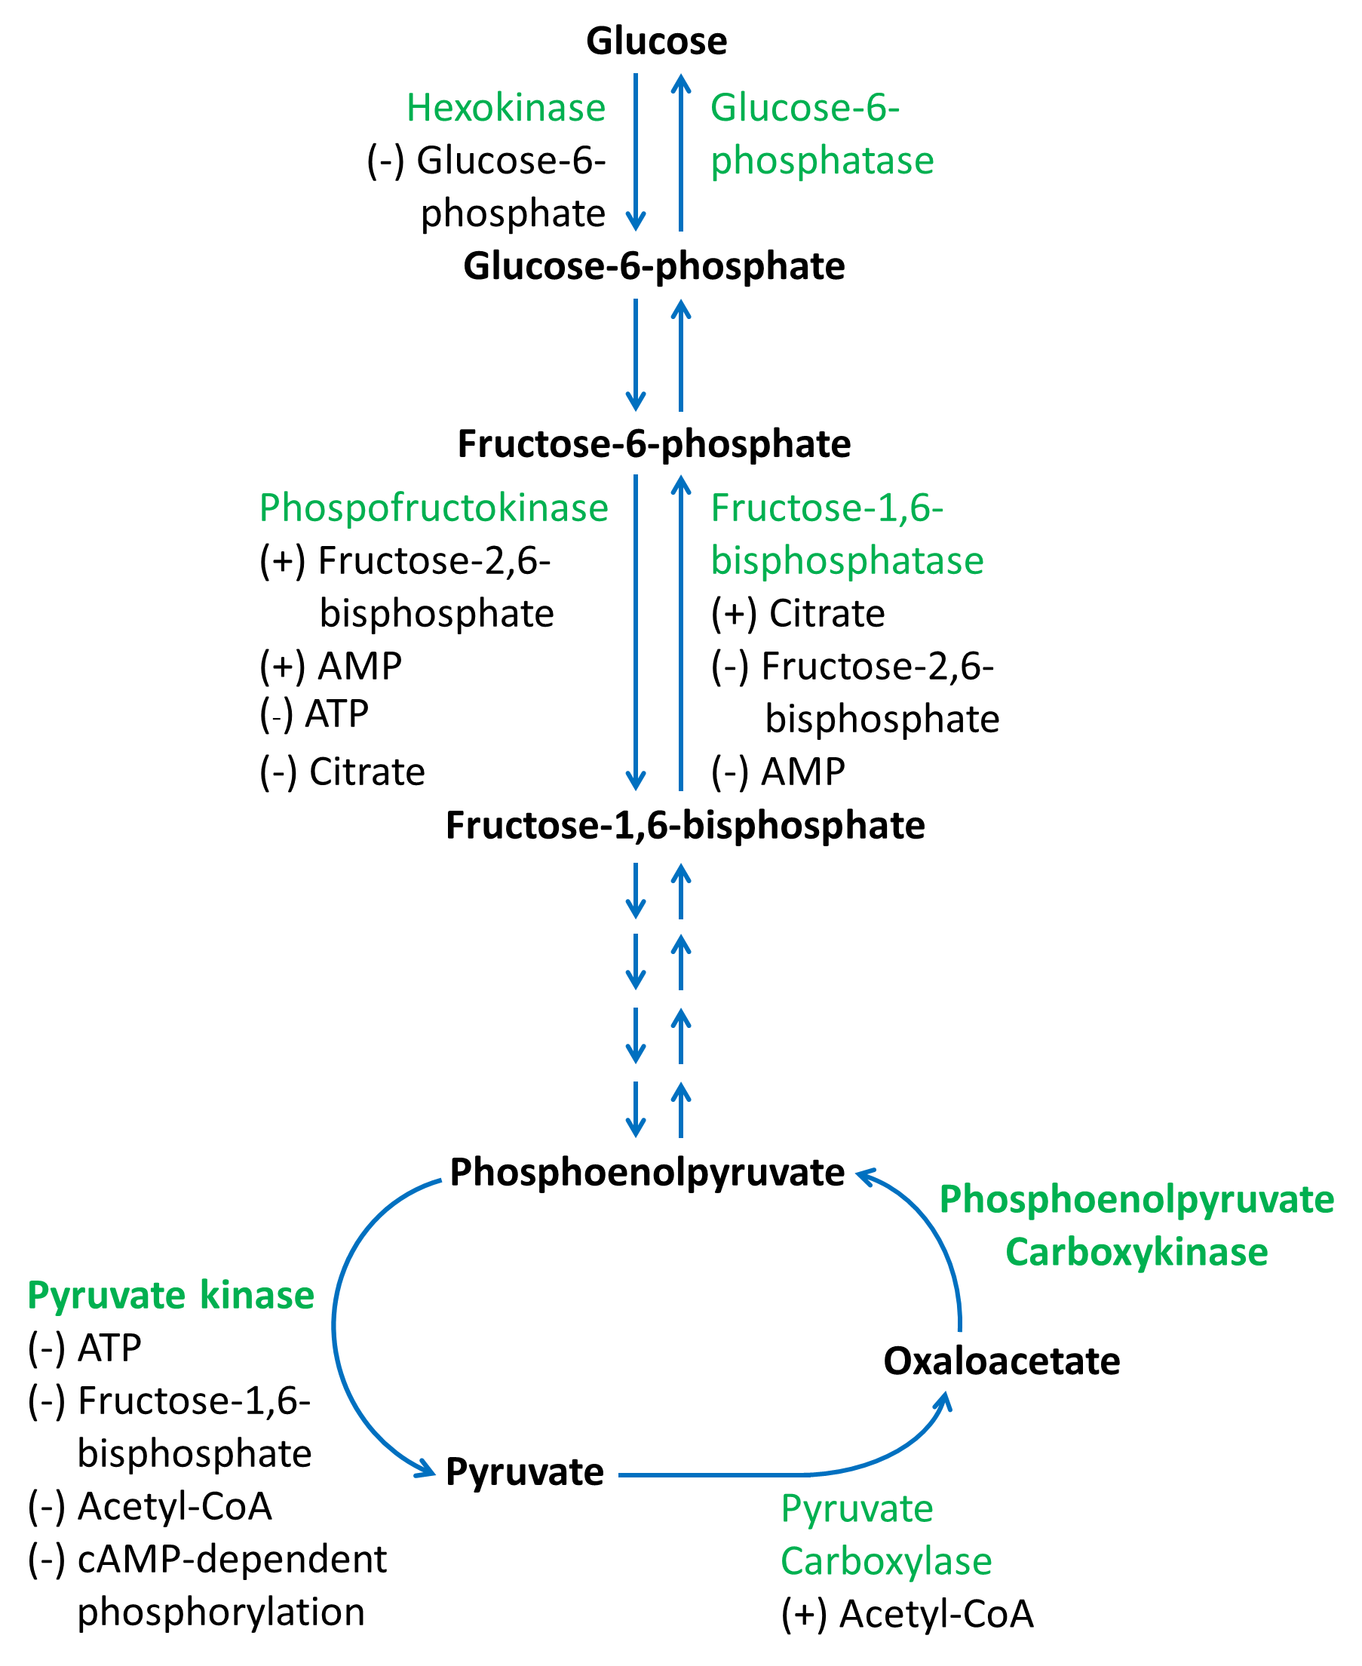
Regulation of
Glyconeogenesis

Slide 25
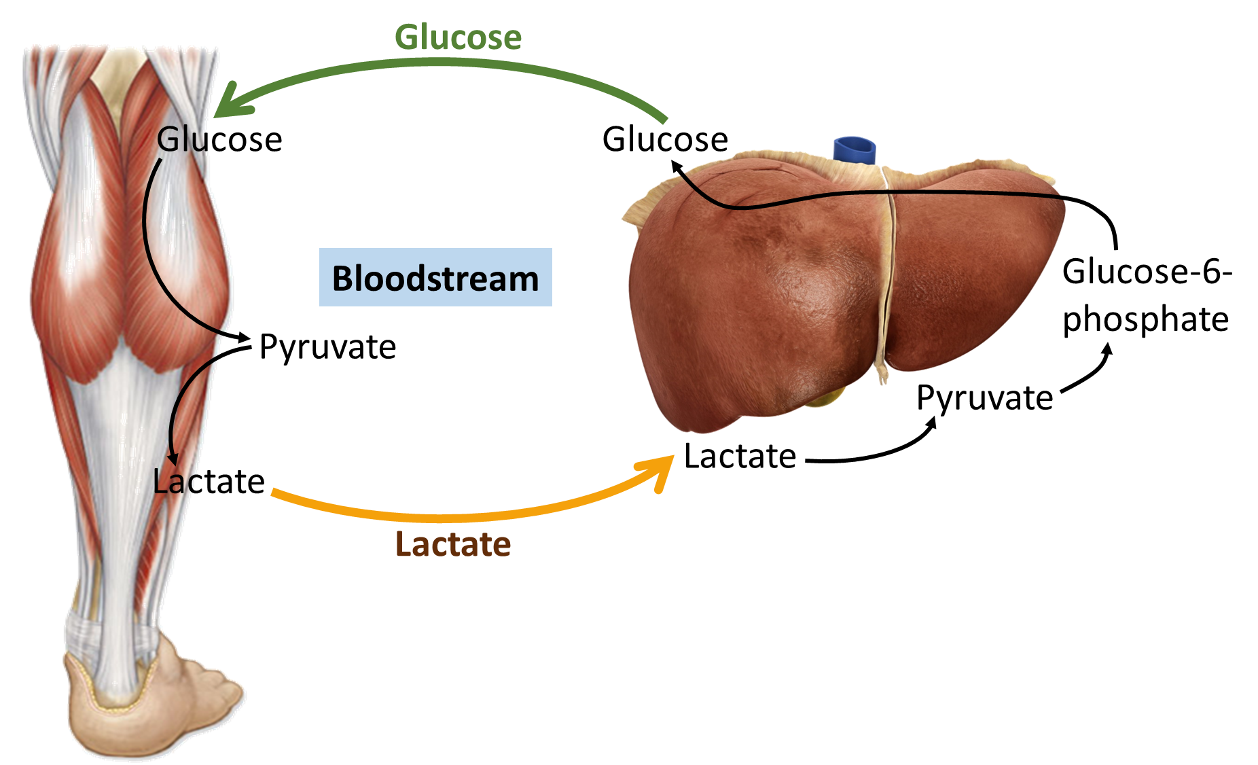
The Cori Cycle

Slide 26
The Cori Cycle
Lactate is released by red blood cells and other cells that lack mitochondria or have low oxygen concentrations. In the Cori cycle, lactate is released by skeletal muscle
during exercise
After passing through blood to the liver,
lactate is converted to glucose by gluconeogenesis.

Slide 27
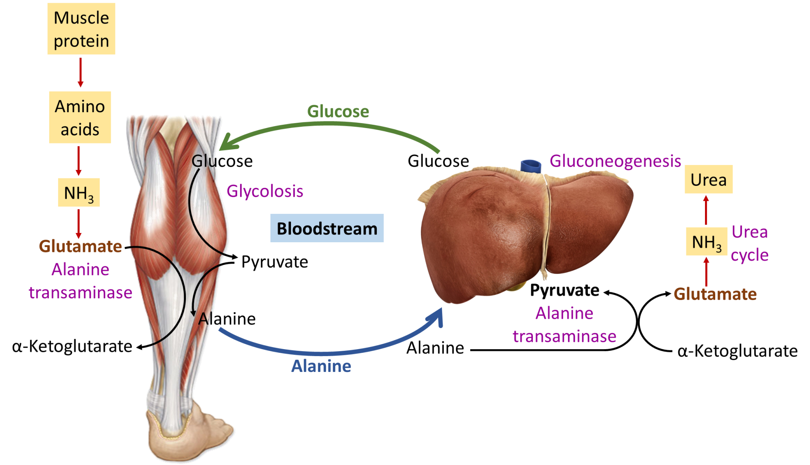
The glucose-alanine cycle

Slide 28
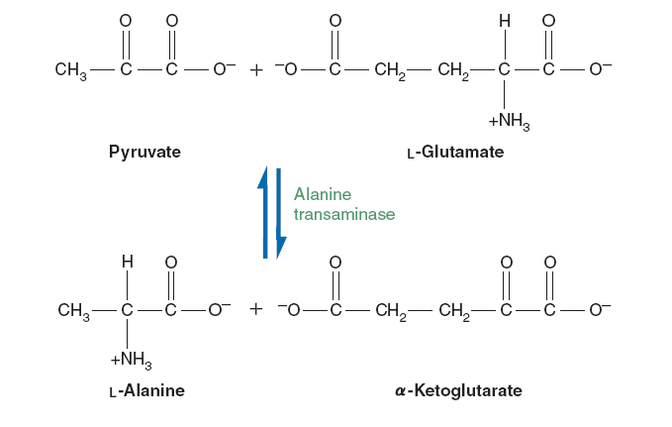
The glucose-alanine cycle
Alanine is formed from pyruvate in muscle. After it has been transported to the liver, alanine is reconverted to pyruvate by alanine transaminase. Eventually pyruvate is used in the synthesis of new glucose. Because muscle cannot synthesize urea from amino nitrogen, the glucose-alanine cycle is used to transfer amino nitrogen to the liver.

Slide 29
Glycerol, a product of fat metabolism in adipose tissue, is transported to the liver in the blood and then converted to glycerol-3-phosphate by glycerol kinase.
Oxidation of glycerol-3-phosphate to form DHAP occurs when cytoplasm NAD+ concentration is relatively high.

Slide 30
GLYCOGENOLYSIS
The breakdown of glycogen
Glycogenolysis is the breakdown of glycogen to glucose-6-phosphate and glycogen (n-1).
Glycogen branches are catabolized by the sequential removal of glucose monomers via phosphorolysis, by the enzyme glycogen phosphorylase
glycogen(n residues) + Pi ⇌ glycogen(n-1 residues) + glucose-1-phosphate

Slide 31
Glycogenolysis takes place in the cells of the muscle and liver tissues in response to hormonal and neural signals. In particular, glycogenolysis plays an important role in the fight-or-flight response and the regulation of glucose levels in the blood.

Slide 32
In myocytes (muscle cells), glycogen degradation serves to provide an immediate source of glucose-6-phosphate for glycolysis, to provide energy for muscle contraction.
In hepatocytes (liver cells), the main purpose of the breakdown of glycogen is for the release of glucose into the bloodstream for uptake by other cells. The phosphate group of glucose-6-phosphate is removed by the enzyme glucose-6-phosphatase, which is not present in myocytes, and the free glucose exits the cell via GLUT2 facilitated diffusion channels in the hepatocyte cell membrane.

Slide 33
Glycogen degradation requires the following two reactions.
Removal of glucose from the nonreducing ends of glycogen. Glycogen phosphorylase uses inorganic phosphate (Pi) to cleave the α(1,4) linkages on the outer branches of glycogen to yield glucose-1-phosphate. Glycogen phosphorylase stops when it comes within four glucose residues of a branch point.
(A glycogen molecule that has been degraded to its
branch points is called a limit dextrin.)

Slide 34
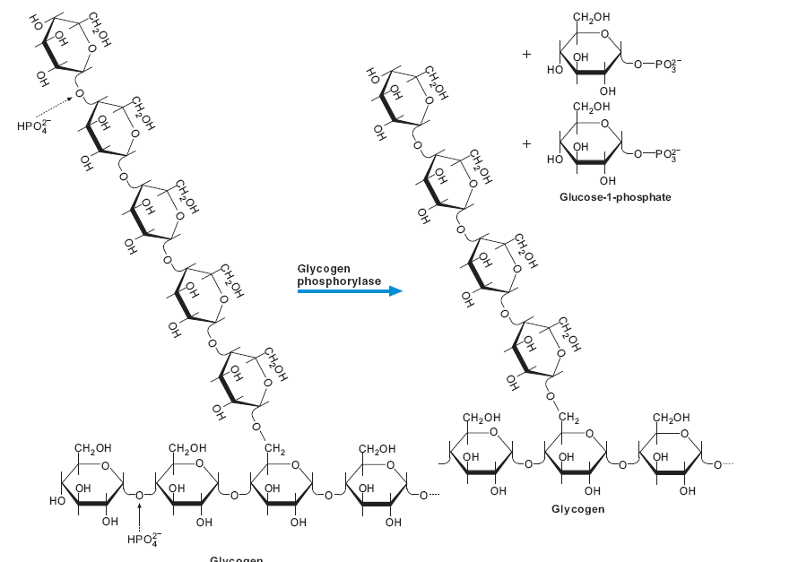

Slide 35
2. Hydrolysis of the a α (1,6) glycosidic bonds at branch points of glycogen. Amylo- α (1,6)-glucosidase, also called debranching enzyme, begins the removal of
α (1,6) branch points by transferring the outer three of the four glucose residues attached to the branch point to a nearby nonreducing end. It then removes the single glucose residue attached at each branch point.
The product of this latter reaction is free glucose.

Slide 36
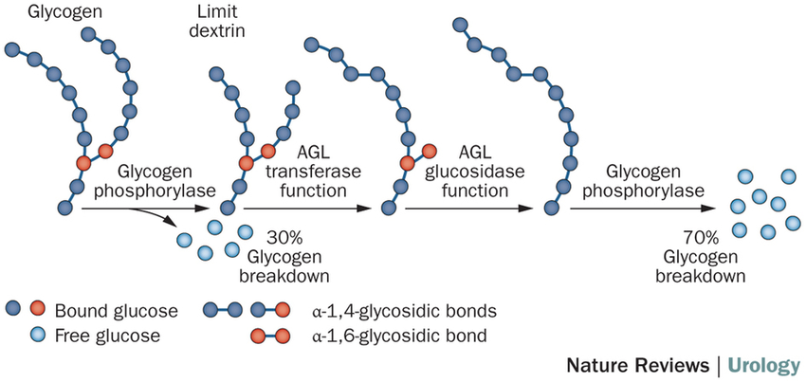

Slide 37
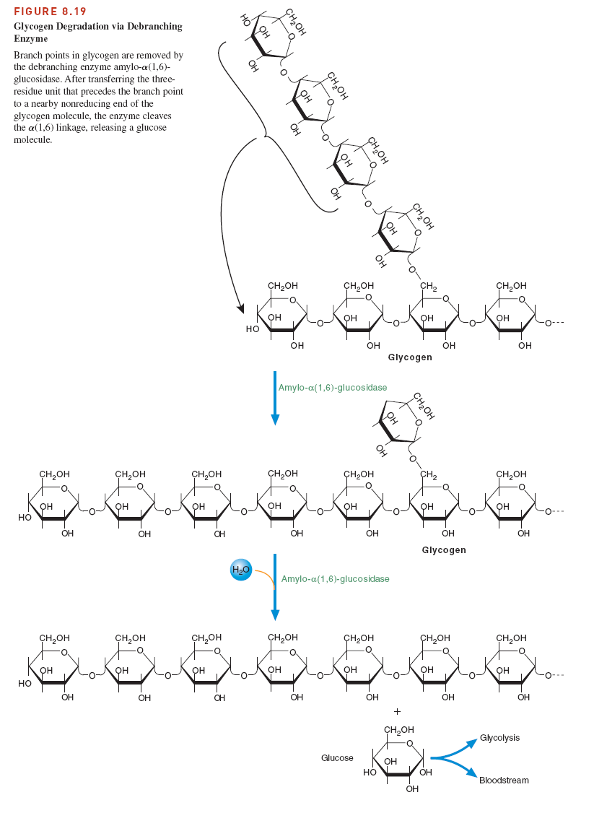

Slide 38
Glucose-1-phosphate, the major product of glycogenolysis, is diverted to glycolysis in muscle cells to generate energy for muscle contraction.
In hepatocytes, glucose-1-phosphate is converted to glucose, by phosphoglucomutase and
glucose-6-phosphatase, which is then released into the blood.

Slide 39
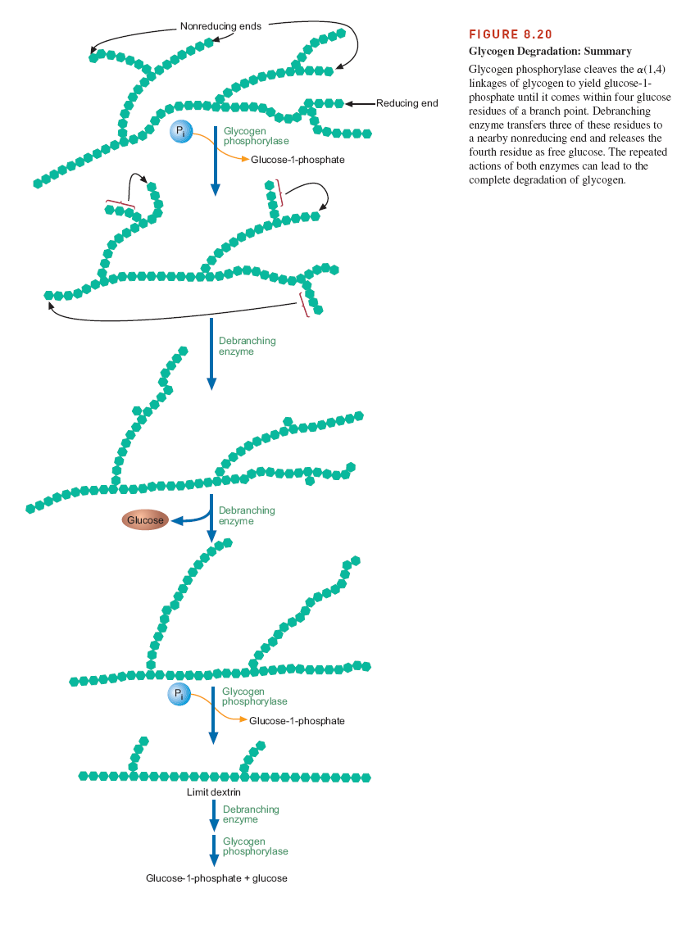

Slide 40
https://www.youtube.com/watch?v=1R6KB12Wtyw&t=69s
Glycogenesis and Glycogenolysis Animation

Slide 41
GLYCOGENESIS
(Glycogen synthesis)
Glycogen synthesis occurs after a meal, when blood glucose levels are high. It has long been recognized that the consumption of a carbohydrate meal is followed
promptly by liver glycogenesis. The synthesis of glycogen from glucose-6-phosphate involves the following set of reactions.
Synthesis of glucose-1-phosphate
Synthesis of UDP-glucose
Synthesis of glycogen from UDP-glucose

Slide 42
Synthesis of glucose-1-phosphate

Slide 43
2. Synthesis of UDP-glucose
Formation of UDP-glucose, whose ∆G◦’ value is near zero, is
a reversible reaction catalyzed by UDP-glucose pyrophosphorylase
However, the reaction is driven to completion because pyrophosphate (PPi)
is immediately and irreversibly hydrolyzed by pyrophosphatase with a large
loss of free energy (∆G◦’ 33.5 kJ/mol):

Slide 44
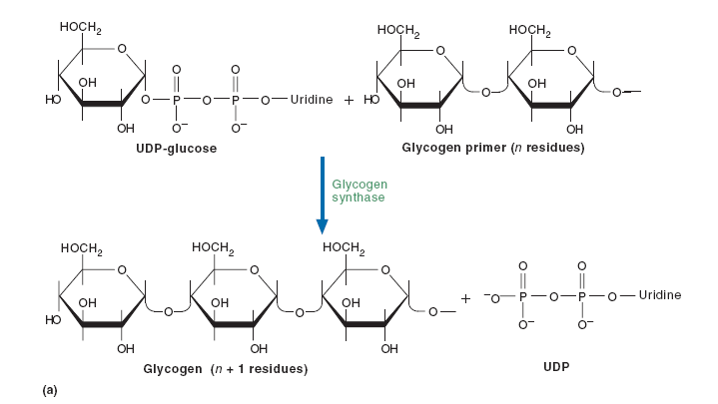
3. Synthesis of glycogen from UDP-glucose
The enzyme glycogen synthase breaks the ester linkage of UDP-glucose and forms an α (1,4) glycosidic bond between glucose and the growing glycogen chain.

Slide 45
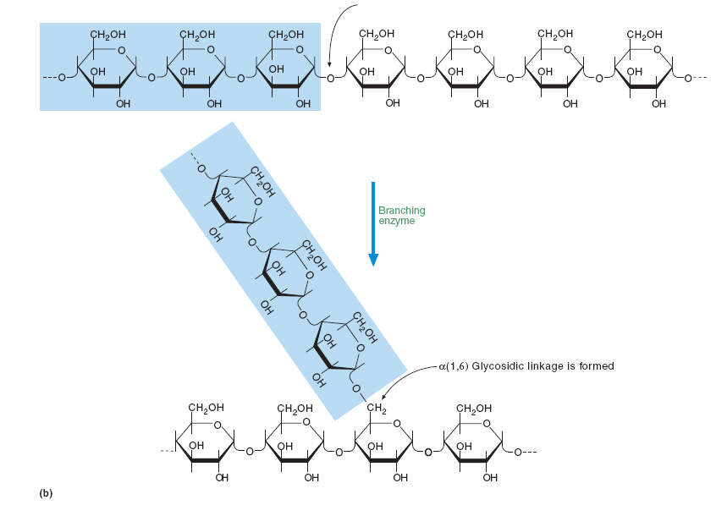
Branching enzyme is responsible for the synthesis of α (1,6) linkages in glycogen.

Slide 46
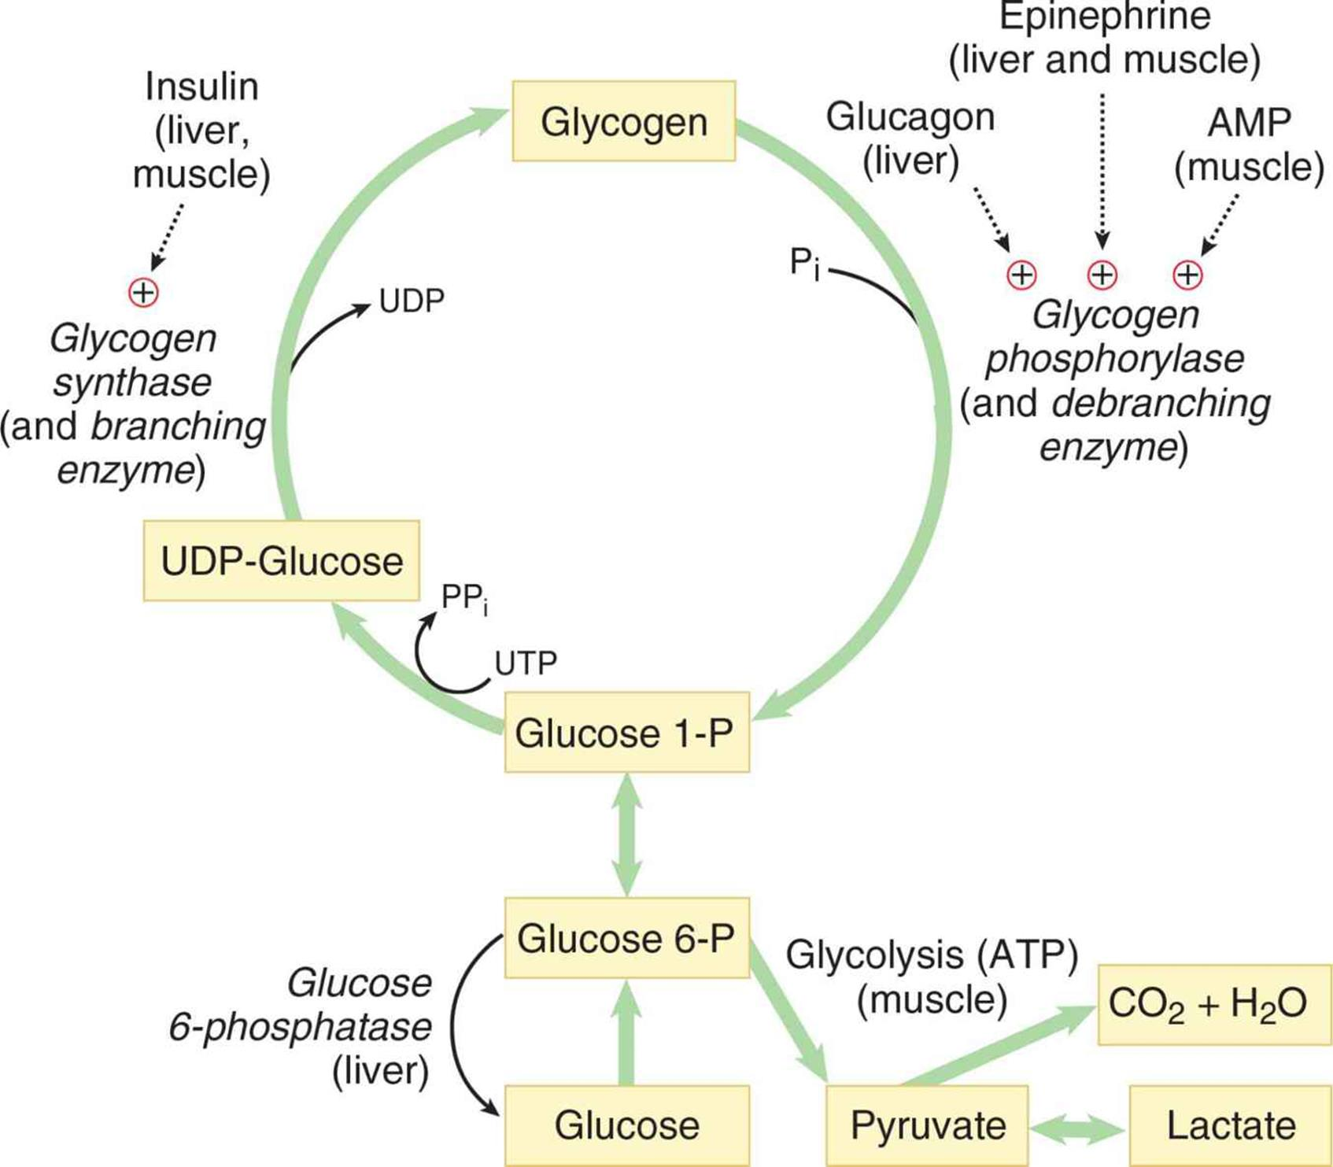

Slide 47
THE PENTOSE PHOSPHATE PATHWAY
The pentose phosphate pathway is an alternative metabolic pathway for glucose oxidation in which no ATP is generated. Its principal products are NADPH, a
reducing agent required in several anabolic processes, and ribose-5-phosphate, a structural component of nucleotides and nucleic acids.
The pentose phosphate pathway occurs in the cytoplasm in two phases: oxidative and nonoxidative.

Slide 48
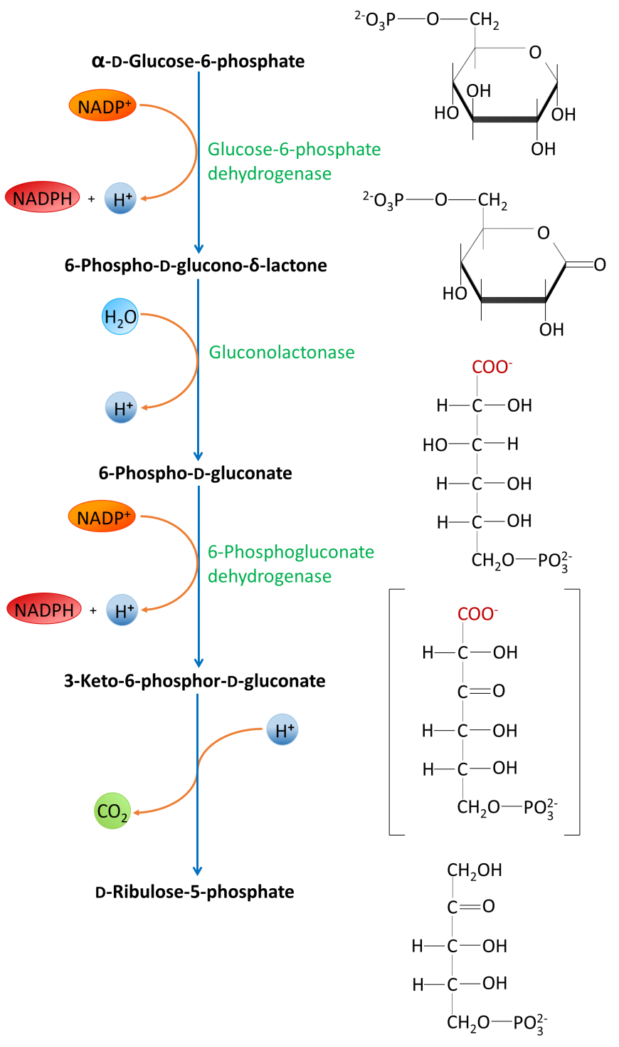
The oxidative phase.
NADPH is an important product of these reactions.

Slide 49
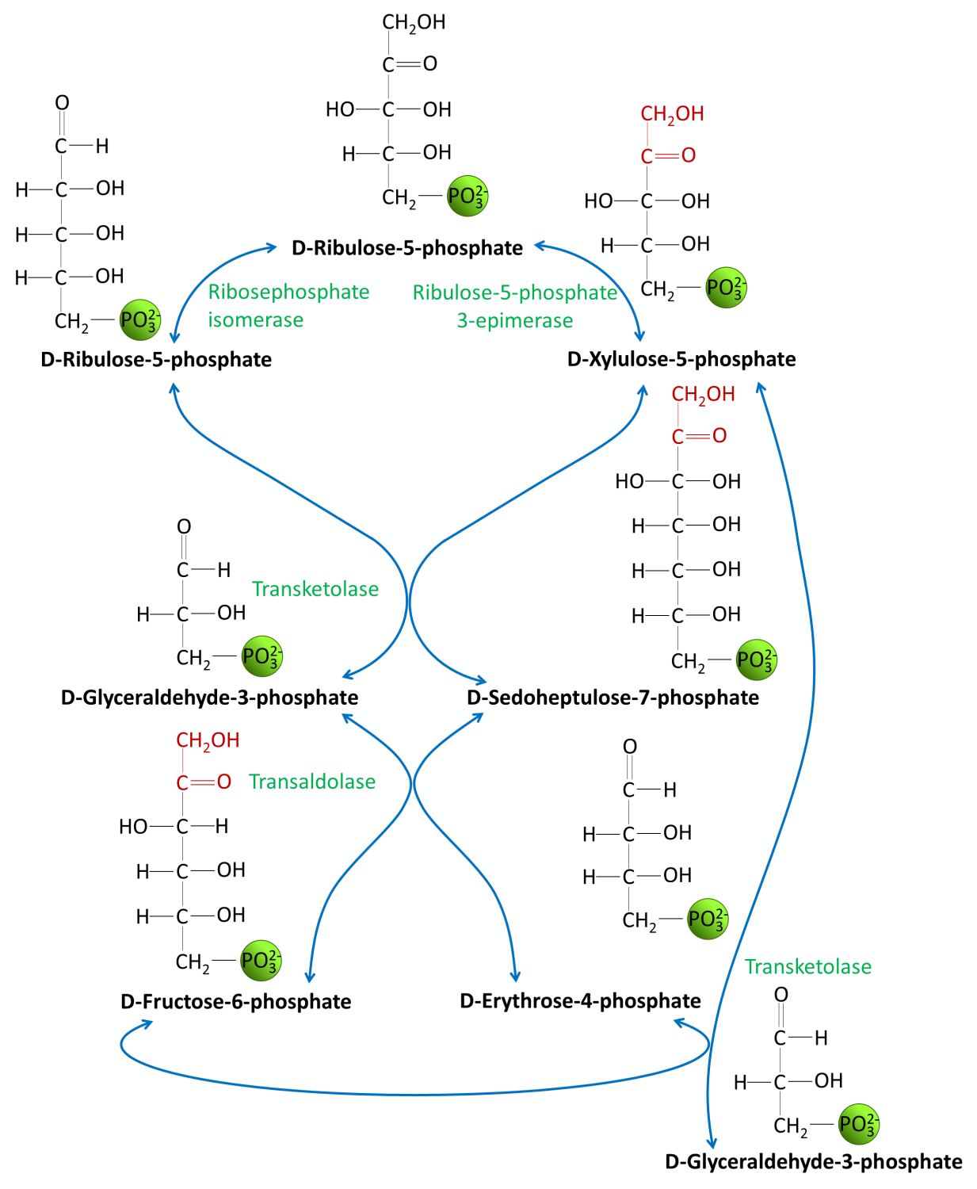
The nonoxidative phase.
When cells require more
NADPH than pentose phosphates,
the enzymes in the
nonoxidative phase convert
ribose-5-phosphate into the
glycolytic intermediates
fructose-6-phosphate and
glyceraldehyde-3-phosphate.

Slide 50
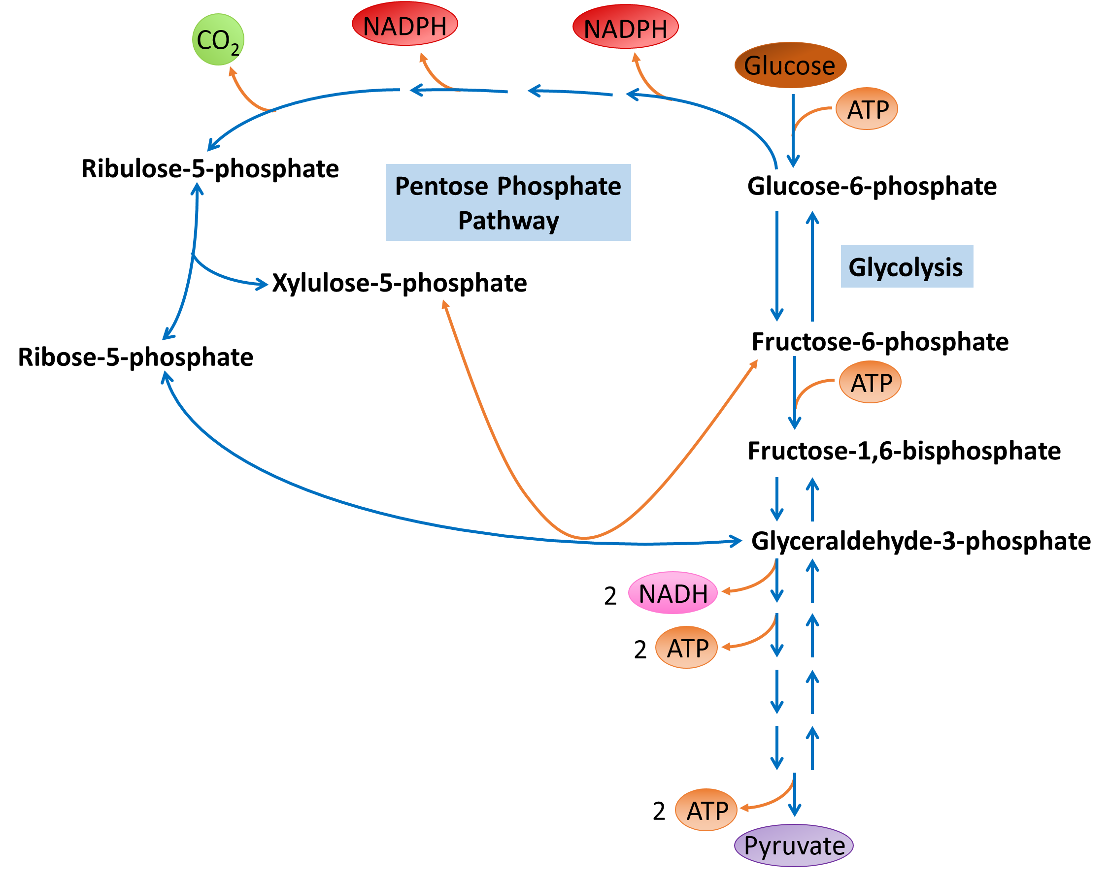
Glycolysis and the Pentose Phosphate Pathway

Slide 51
Fructose Metabolism

Slide 52
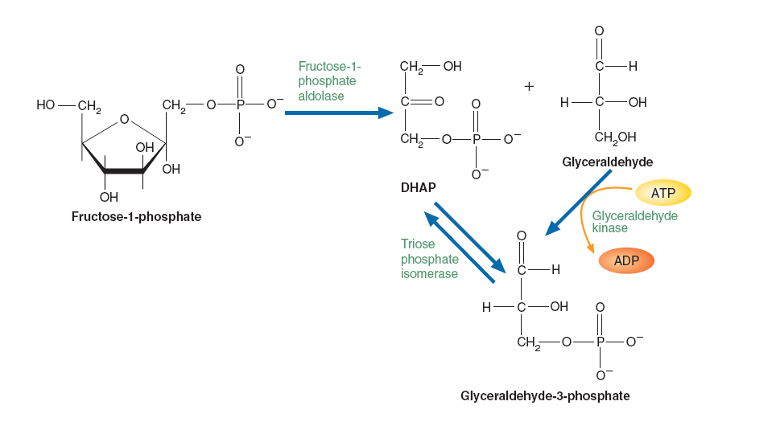

Slide 54
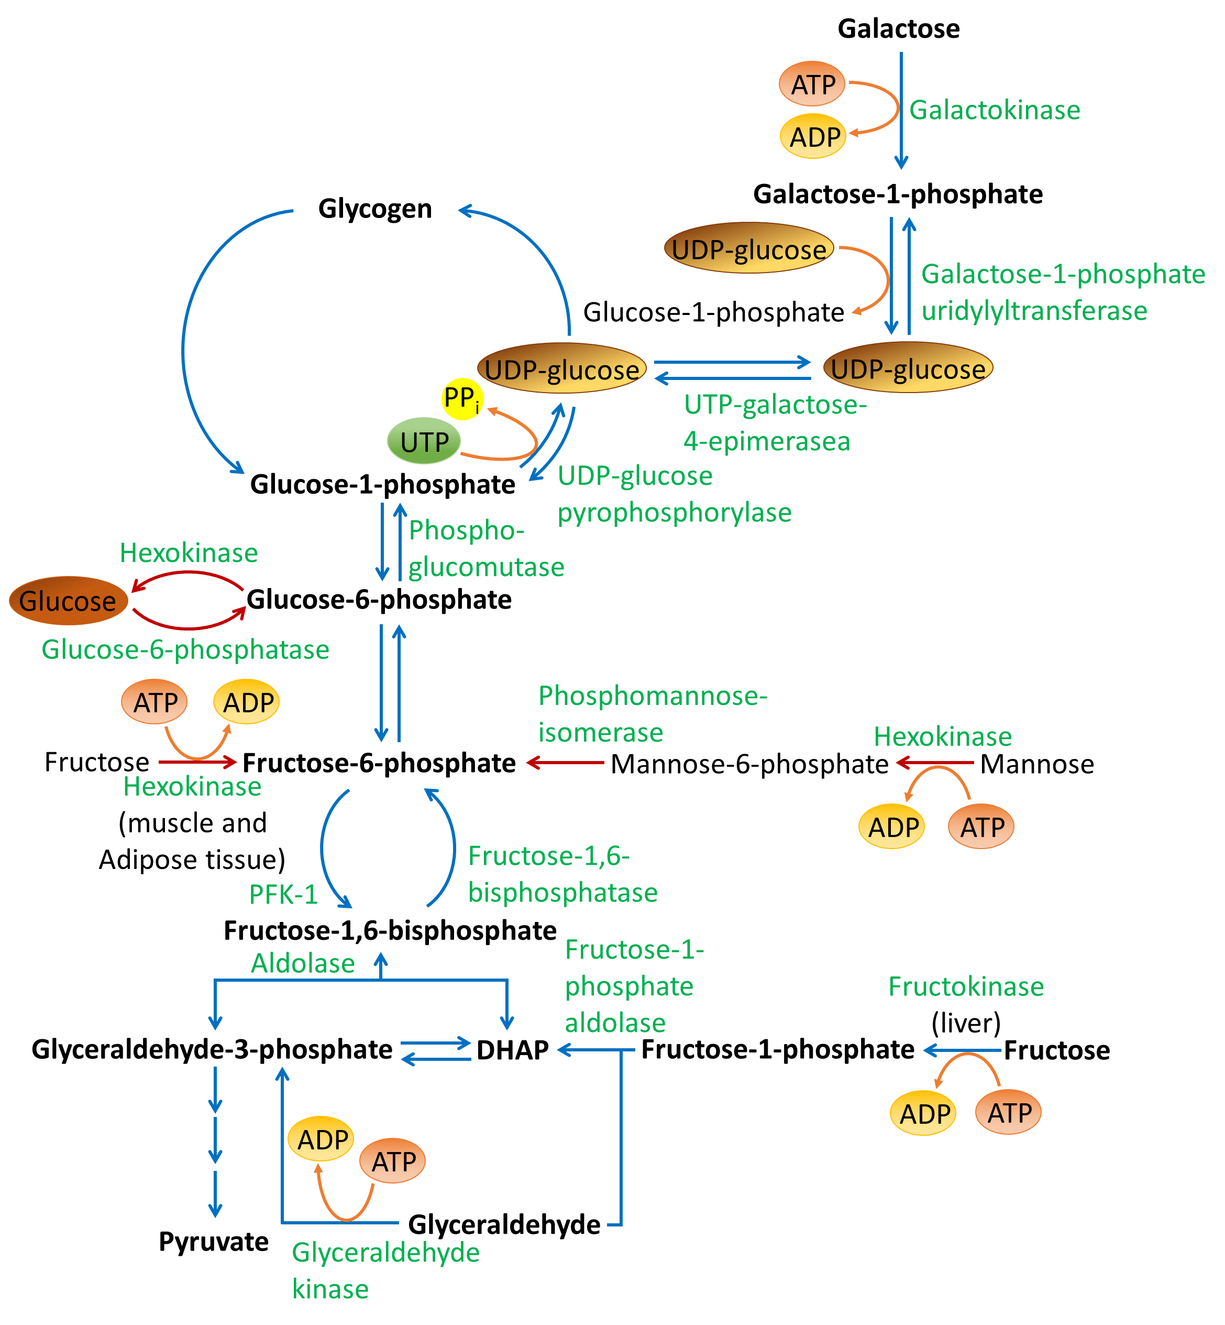
METABOLISM OF OTHER
IMPORTANT SUGARS

